Slide 1


Accessibility and Data
2025
frank.computer
As told from my perspective in data visualization.
Frank Elavsky
hcii.cmu.edu, axle-lab.com, dig.cmu.edu
Notes:
Hey everyone, I am Frank Elavsky, a PhD student and researcher at Carnegie Mellon University. I research, engineer, design, and contribute to standards at the intersection of accessibility and visualization. This is my jam.
Today I hope to go over the important concepts, history, practice for what accessibility and visualization means.

Slide 2
Today
Intro accessibility and models of disability
A “light” walkthrough evaluating a visualization with Chartability
A short highlight of some of my more recent work

Slide 3
What is accessibility?

Slide 4
Why does
accessibility matter?

Slide 5
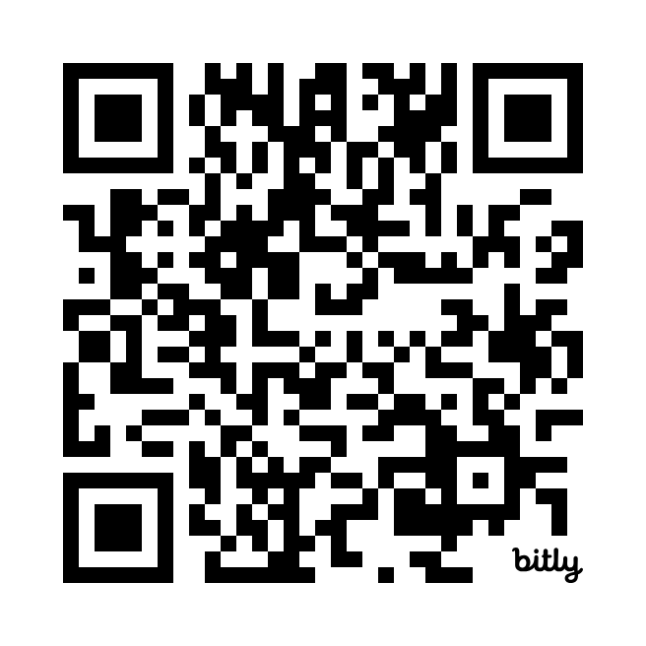
What is accessibility?
Why does accessibility matter?

Slide 6
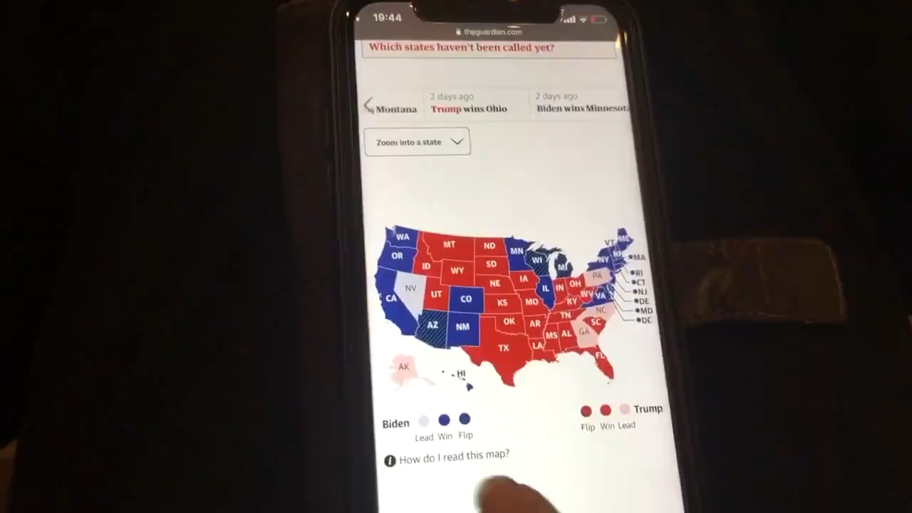
What is an inaccessible experience like?
Credit: Sarah Fossheim on twitter
Notes:
Explain focus indicator before the video begins!
So what I have here is a video by Sarah Fossheim showing what an online map of the US 2020 presidential elections sounds like to a screen reader. I love this video and have shared it many times over the years in my talks. So a screen reader navigates content on a screen and announces information about that content to its user. This assistive technology is most commonly used by folks who are blind or low vision, although others use screen readers too. And in this video Sarah is swiping to navigate this map. The navigation is shown visually with a white border outline called a focus indicator. But all that is read out is "image, image, image" repeatedly. That means that proper alternative text or labels were not supplied to each of these states.
Ideally, someone who uses a screen reader will need to know what state they've navigated to and who won that state. That's what is shown visually.
And this experience I shared here is incredibly common for screen reader users. Most data visualizations and maps are inaccessible. Often even worse than this.

Slide 7

Access is a human right
Accessibility for people with disabilities is an internationally recognized human right.
It is the morally and ethically correct thing to do.
UN CRPD Article 9: Accessibility, UN CRPD Article 10: Right to Life
Notes:
The best answer to the question is that accessibility for people with disabilities is a human right. There are some great articles drafted by the united nations on the rights of people with disabilities.
We should do this work because it is right to do. Simple enough.

Slide 8
Disability is Widespread
Worldwide more than 1.3 billion people (~16%) experience some form of disability [World Health Organization, 2023]
Notes:
Interestingly this number has gone down in the last 10 years but likely more due to definitions than actual people experiencing a disability

Slide 9
Disability is Widespread
(Roughly) One in four Americans has disability of some sort
One in ten Americans has a severe disability
“An impairment that significantly limits one or more major life activities”

Slide 10
~26% of people living in the United States self-report living with a disability that affects their daily life (2017)
4.1%
Color Vision Deficiency
4.5%
Blindness, Low Vision
10.8%
Cognitive, Neurological
13.7%
Motor, Dexterity
7.4%
Vestibular, Motion
Source: Okoro et al. “Prevalence of Disabilities and Health Care Access by Disability Status and Type Among Adults”
Notes:
Who is disabled? And what does disability look like?
According to the CDC’s research, 27% of people living in the United States self-report living with a disability that affects their daily life.
Here we see what those might look like, and keep in mind that the numbers don’t add up to 27% because they aren’t exclusive:
4.1% have color vision deficiency, 4.5% are blind or low vision, 10.8% have cognitive or neurological disability, 13.7% -the largest- is for motor, dexterity and mobility related disability, and 7.4% is related to vestibular, motion, and balance disorders.

Slide 11
~27% of people living in the United States self-report living with a disability that affects their daily life (2023)
4.1%
Color Vision Deficiency*
4.8%
Blindness, Low Vision
12.8%
Cognitive, Neurological
12.1%
Motor, Dexterity
7.4%
Vestibular, Motion*
Centers for Disease Control and Prevention. Disability and Health Data System (DHDS). 2023. Available from: http://dhds.cdc.gov
*No new data
Notes:
Who is disabled? And what does disability look like?
According to the CDC’s research, 27% of people living in the United States self-report living with a disability that affects their daily life.
Here we see what those might look like, and keep in mind that the numbers don’t add up to 27% because they aren’t exclusive:
4.1% have color vision deficiency, 4.5% are blind or low vision, 10.8% have cognitive or neurological disability, 13.7% -the largest- is for motor, dexterity and mobility related disability, and 7.4% is related to vestibular, motion, and balance disorders.

Slide 12
Cognitive disability is on the rise
4.1%
Color Vision Deficiency*
4.8%
Blindness, Low Vision
10.8% (pre-covid)
12.8%
Cognitive, Neurological
12.1%
Motor, Dexterity
7.4%
Vestibular, Motion*
Centers for Disease Control and Prevention. Disability and Health Data System (DHDS). 2023. Available from: http://dhds.cdc.gov
*No new data
Notes:
Who is disabled? And what does disability look like?
According to the CDC’s research, 27% of people living in the United States self-report living with a disability that affects their daily life.
Here we see what those might look like, and keep in mind that the numbers don’t add up to 27% because they aren’t exclusive:
4.1% have color vision deficiency, 4.5% are blind or low vision, 10.8% have cognitive or neurological disability, 13.7% -the largest- is for motor, dexterity and mobility related disability, and 7.4% is related to vestibular, motion, and balance disorders.

Slide 13
Accessibility affects every aspect of visualization work
Visual design
4.1%
Color Vision Deficiency
Non-visual design
4.8%
Blindness, Low Vision
Narrative design, statistics, storytelling
12.8%
Cognitive, Neurological
12.1%
Motor, Dexterity
Interaction design, device considerations, performance
7.4%
Vestibular, Motion
Animation, transitions
Notes:
And every type of disability informs the design of an accessible visualization. From the visual and non-visual design considerations, to the stories and statistics we discuss, the interaction design, device considerations, and animations and use of motion.
We should be designing for and with people with disabilities in every aspect of our work.
So what is the state of accessibility right now? I have a silly little diagram I use to set the mood here.

Slide 14
Creators
Notes:
Creators

Slide 15
Creators
Tools
Notes:
Use tools

Slide 16
Creators
Tools
Things
Notes:
To make things

Slide 17
Creators
Tools
Things
Future Things
Notes:
And over time, we make more and more things.

Slide 18
But how much of this is inaccessible?
Creators
Tools
Things
Future Things
Notes:
Does anyone want to guess what percentage of stuff out there is inaccessible in at least one way for people with disabilities? What percentage do we think this number looks like?

Slide 19
What % of existing content out there is measurably inaccessible in some way?

Slide 20
Who is responsible for making things accessible?

Slide 21
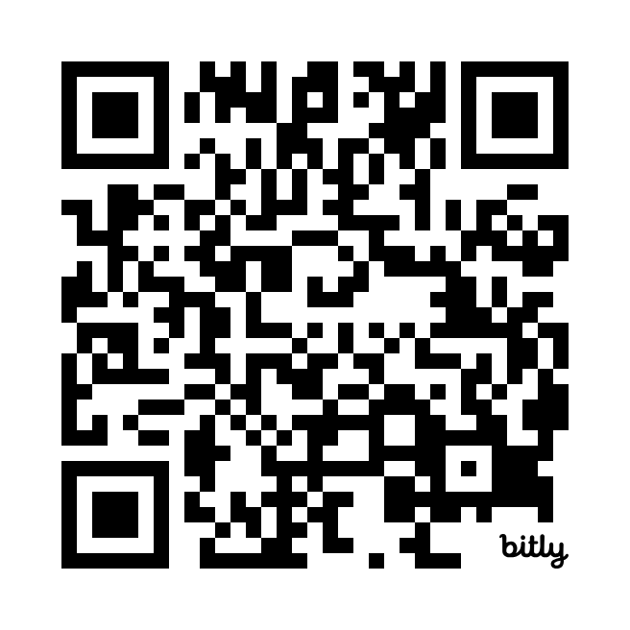
What % of existing content out there is measurably inaccessible in some way?
Who is responsible for making things accessible?

Slide 22
97-99%
Source: World Wide Web Consortium. “The WebAIM Million Report.” 2019-2024
Creators
Tools
Things
Future Things
Notes:
On the web? Almost all of it. On a given year, between 97 and 99% of stuff is inaccessible in some way. And on social media, research studies show it is between 98 and 99.99% inaccessible, depending on the method of measurement.
You know what scares me? This rate stays roughly the same, but each year we are putting more and more stuff out there. That’s a terribly hostile landscape for people with disabilities to navigate. And it is also really hard to fix as time goes on.

Slide 23
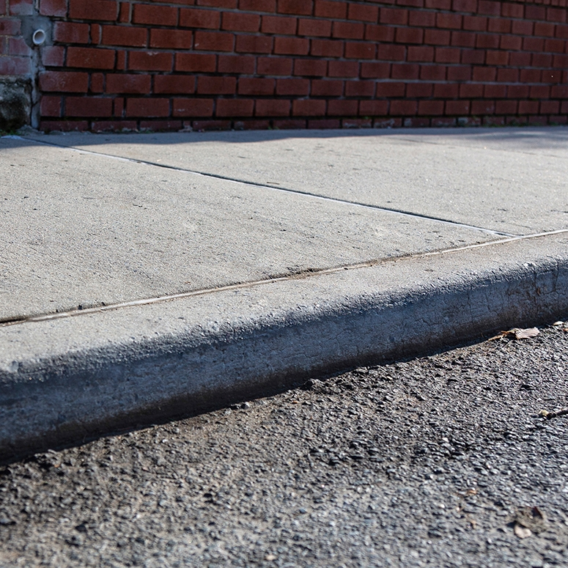
What about curbs in our cities?
Notes:
So curbs and wheelchairs don’t mix. This is a real, historical problem. And historically for the last couple hundred years, the medical model of disability has been the dominant approach to problems like our curb-wheelchair dilemma.

Slide 24
Medicalizing framing: the body is the cause/location of disability (according to normative standards).
Notes:
The medical model believes that the body is the cause of disability. Or really, that the body is where disability is located. This is according to normative standards. Generally speaking, this is how medicine operated for a long time (and still philosophically is how many people think of disability still). We can, in some ways, thank the medical model for some stuff. The wheelchair is a result of the medical model. Medicine, which is great, is also largely the result of the medical model.

Slide 25
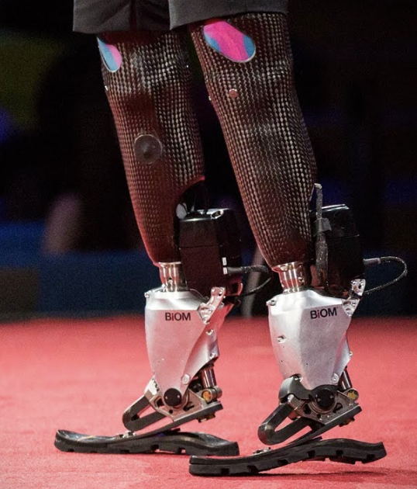
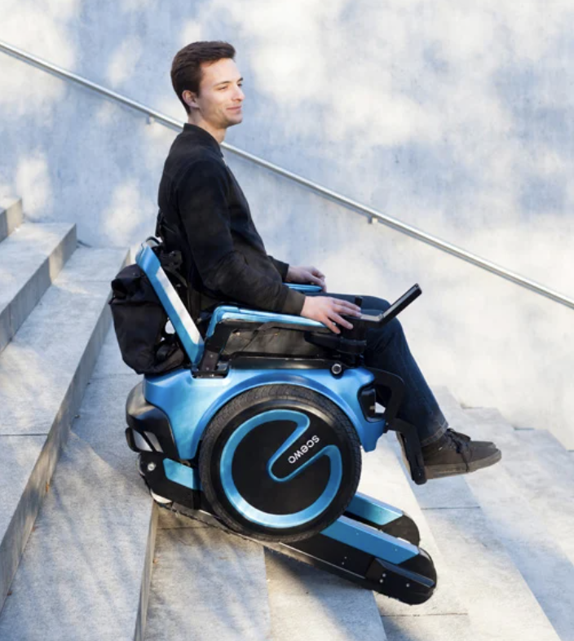
Augment or “cure” the body, the person typically bears the cost of access.
Notes:
But in the curb-wheelchair dilemma, the medical model would seek to augment or “cure” the body. And a lot of medical and technological projects still to this day look to augment or cure an individual’s disability in order to overcome things like stairs or curbs.
But this puts the burden on an individual to access and afford these fancy new inventions, which are often really impractical. Most stair climbing prototype wheelchairs are over 1000 pounds and 15000 dollars or more to produce.

Slide 26
Social framing: The curb is the source/location where disability is produced (as a “barrier” to access).
Notes:
But there is another way to frame disability. And that is that the curb, which is an artificial thing that we humans have made, is the barrier. And these artificial barriers are where disability is located or, rather, produced. Disability then, in the social model, is produced by human-made things - whether those are laws and norms, or physical or technological structures.

Slide 27
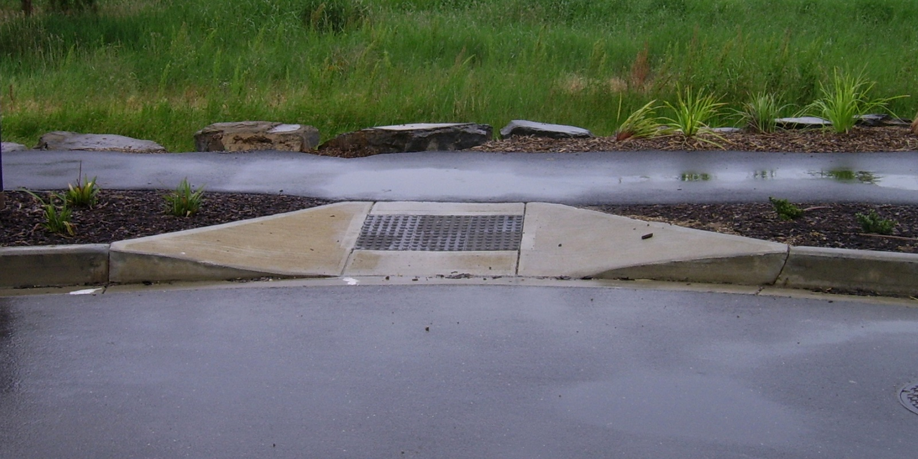
We built barriers, so now we need to fix them.
Notes:
So the social model takes action on the environment, on the constructed things. The social model cuts the curb.
Why do we call it the social model? Because in the medical model, medicine “solves” disability on the body, but in the social model, WE, the creators of the world around us, are the ones who get rid of barriers. Historically speaking, it took advocacy to get curbs cut and standardized. And largely, people benefitted from cutting curbs, even folks who don’t use wheelchairs. People are much safer when crossing streets. The studies related to this phenomenon call this the “curb-cut” effect.

Slide 28
Question for Frank

Slide 29
Concept: Ability Assumptions
Notes:
That leads us to the next concept: ability assumptions.

Slide 30
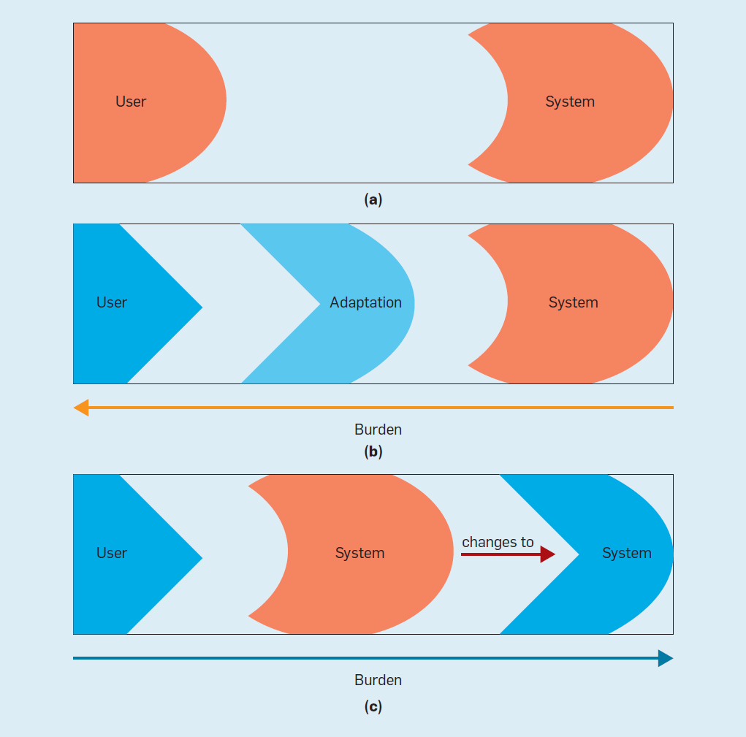
Ability Assumptions
(Wobbrock et al) https://cacm.acm.org/magazines/2018/6/228034-ability-based-design/fulltext
Notes:
Wobbrock et al set out to frame technology research and design in what he calls Ability Based Design, or a focus on explicitly designing for what people can do. In order to do this, we need to question our design assumptions about who users are and what they can do.
So in typically design fashion, designers often imagine what users can do and then build a system that fits those user’s abilities.

Slide 31
Ability Assumptions
(Wobbrock et al) https://cacm.acm.org/magazines/2018/6/228034-ability-based-design/fulltext
Notes:
But obviously people have many different abilities and disabilities. So someone who is blind might encounter an interface that doesn’t work for them. And often, the burden is placed on that user, the individual, to find or acquire some kind of adaptation, such as a screen reader or AI or an aide such as a friend, in order to be able to use that interface.
This isn’t ideal.

Slide 32
Ability Assumptions
(Wobbrock et al) https://cacm.acm.org/magazines/2018/6/228034-ability-based-design/fulltext
Notes:
So wobbrock proposes that we build more plastic systems, systems that are designed to support many abilities by default or can adapt automatically to user abilities, disabilities, needs, and preferences.

Slide 33
A curb exclusively assumes the ability to step up
Notes:
In the design of curbs, it was assumed that all members of a city can safely step up the curb with their legs and feet.
That ability assumption was exclusive and it excludes people who use wheelchairs or have balance, mobility, or stability disabilities.

Slide 34
A cut curb has fewer exclusive ability assumptions
Notes:
And of course, a cut curb is more supportive of a broader range of abilities and disabilities by default. A better design.

Slide 35
Question for Frank

Slide 36
Concept: Situational Impairment
Notes:
This leads us to the next concept: situational impairment. And this one is usually when lights start turning on in people’s heads. My own advisor at CMU said that when he learned this, it’s when accessibility really clicked.

Slide 37
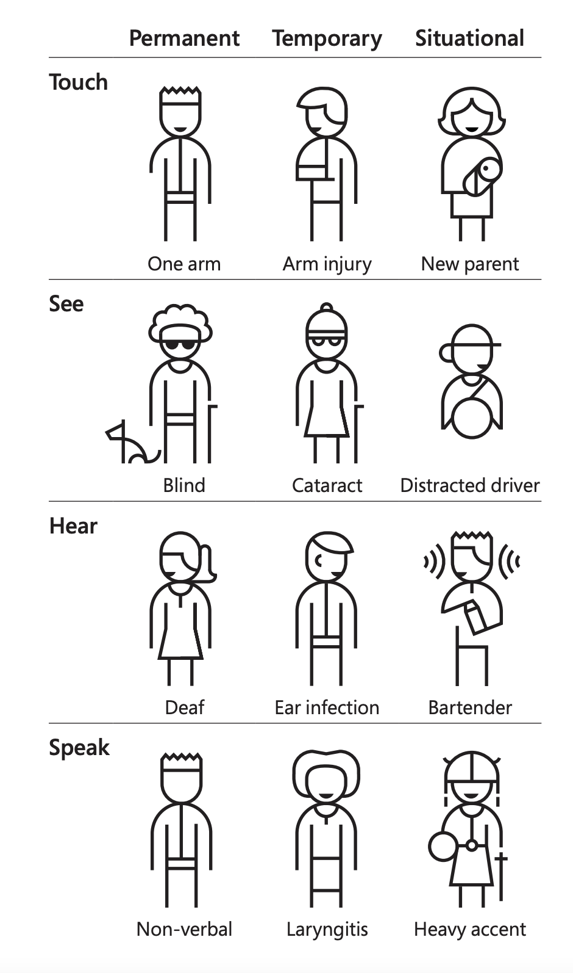
Notes:
So some folks have a permanent condition. In a medicalizing framing, we’d say they have a permanent disability. Someone might be born quadriplegic or lost a limb due to an accident. They permanently do not have use of a limb.

Slide 38
Notes:
But other folks, like someone who fell playing football, simply broke their arm. This is a temporary impairment, what we might call temporary disability.

Slide 39
Notes:
And lastly are situational impairments. This might be a parent holding a baby with one arm.

Slide 40
We all experience situational impairment in our daily lives. Accessibility benefits everyone!
Notes:
So accessibility work that is designed for folks with permanent conditions often also has downstream benefits for folks who are experiencing temporary or situational impairment. This is an extension of the idea behind the curb cut effect. Everyone in this room has experienced situational and temporary impairments in life. And as we age, disability comes for all of us.

Slide 41
“Design for One, Extend to All”
Microsoft’s Inclusive Design 101 Toolkit: https://download.microsoft.com/download/b/0/d/b0d4bf87-09ce-4417-8f28-d60703d672ed/inclusive_toolkit_manual_final.pdf
Notes:
The phrase “design for one, extend to all” is used by Microsoft to capture this idea.
For a lot of folks, this is when they start to realize that accessibility is already all around us. It’s everywhere and has made the worlds we inhabit, both physically and digitally, immensely better. We often take for granted what accessibility has already done for us.
I often use my phone as an example of this. It had a hardware update about 3 years ago and since then it no longer automatically adjusts contrast. I have to manually do this and only really dark or really bright settings are usable. I’m situationally impaired on a bright day. I often cannot even see the surface of my phone when out in the sun. I took for granted that automatically adjusting contrast protects us from the situational impairment of the sun. I’m constantly thinking about the sun now in ways I didn’t used to.

Slide 42
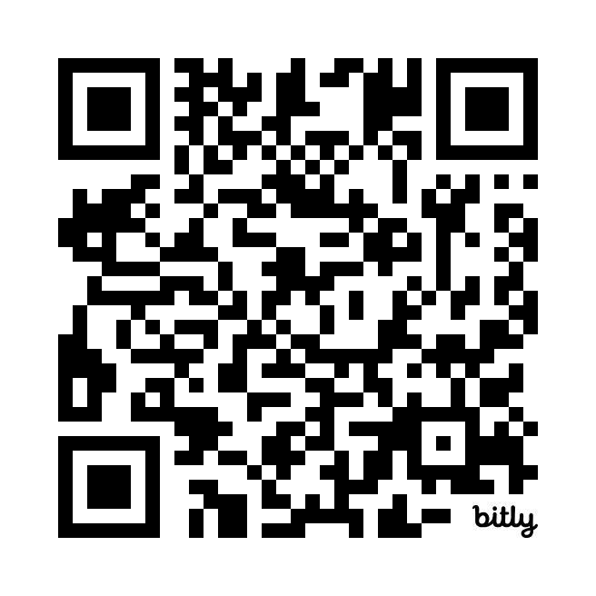
What is a situation you’ve found yourself in where your hearing, sight, voice, or hands were impaired?

Slide 43
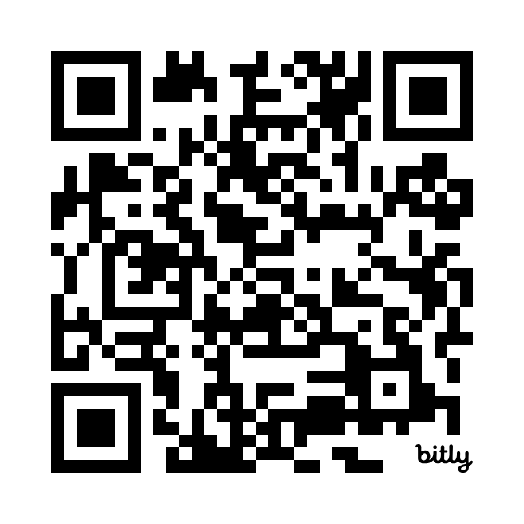
Any other questions?

Slide 44
Turns out, a lot of barriers are shared!
Notes:
In the design of curbs, it was assumed that all members of a city can safely step up the curb with their legs and feet.
That ability assumption was exclusive and it excludes people who use wheelchairs or have balance, mobility, or stability disabilities.

Slide 45
So how do we catch barriers?

Slide 46
Listen to people with disabilities (PWD).

Slide 47
There are a lot of ways to listen:
Actually ask them!
Find where they are already speaking
Find where they have already spoken:
Research
Blog posts
Accessibility standards

Slide 48
There are a lot of ways to listen:
Actually ask them!
Find where they are already speaking
Find where they have already spoken:
Research
Blog posts
Accessibility standards

Slide 49
P
O
U
R
An acronym in web standards:

Slide 50
Perceivable
O
U
R
An acronym in web standards:

Slide 51
Perceivable
Operable
U
R
An acronym in web standards:

Slide 52
Perceivable
Operable
Understandable
R
An acronym in web standards:

Slide 53
Perceivable
Operable
Understandable
Robust
The 4 pillars of accessible design:

Slide 54
Perceivable
Operable
Understandable
Robust
Chartability’s additions:
+
C
A
F
Elavsky et al, “Chartability.” (2022)

Slide 55
Perceivable
Operable
Understandable
Robust
Chartability’s additions:
+
Compromising
A
F
Elavsky et al, “Chartability.” (2022)

Slide 56
Perceivable
Operable
Understandable
Robust
Chartability’s additions:
+
Compromising
Assistive
F
Elavsky et al, “Chartability.” (2022)

Slide 57
Perceivable
Operable
Understandable
Robust
Chartability’s additions:
+
Compromising
Assistive
Flexible
Elavsky et al, “Chartability.” (2022)

Slide 58
Question for Frank

Slide 59
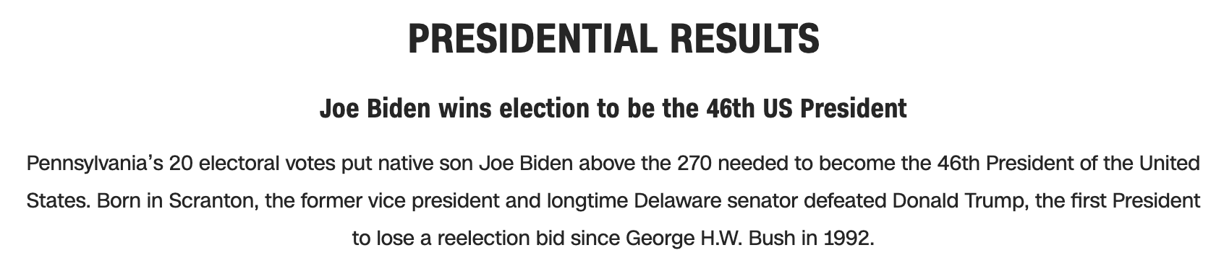
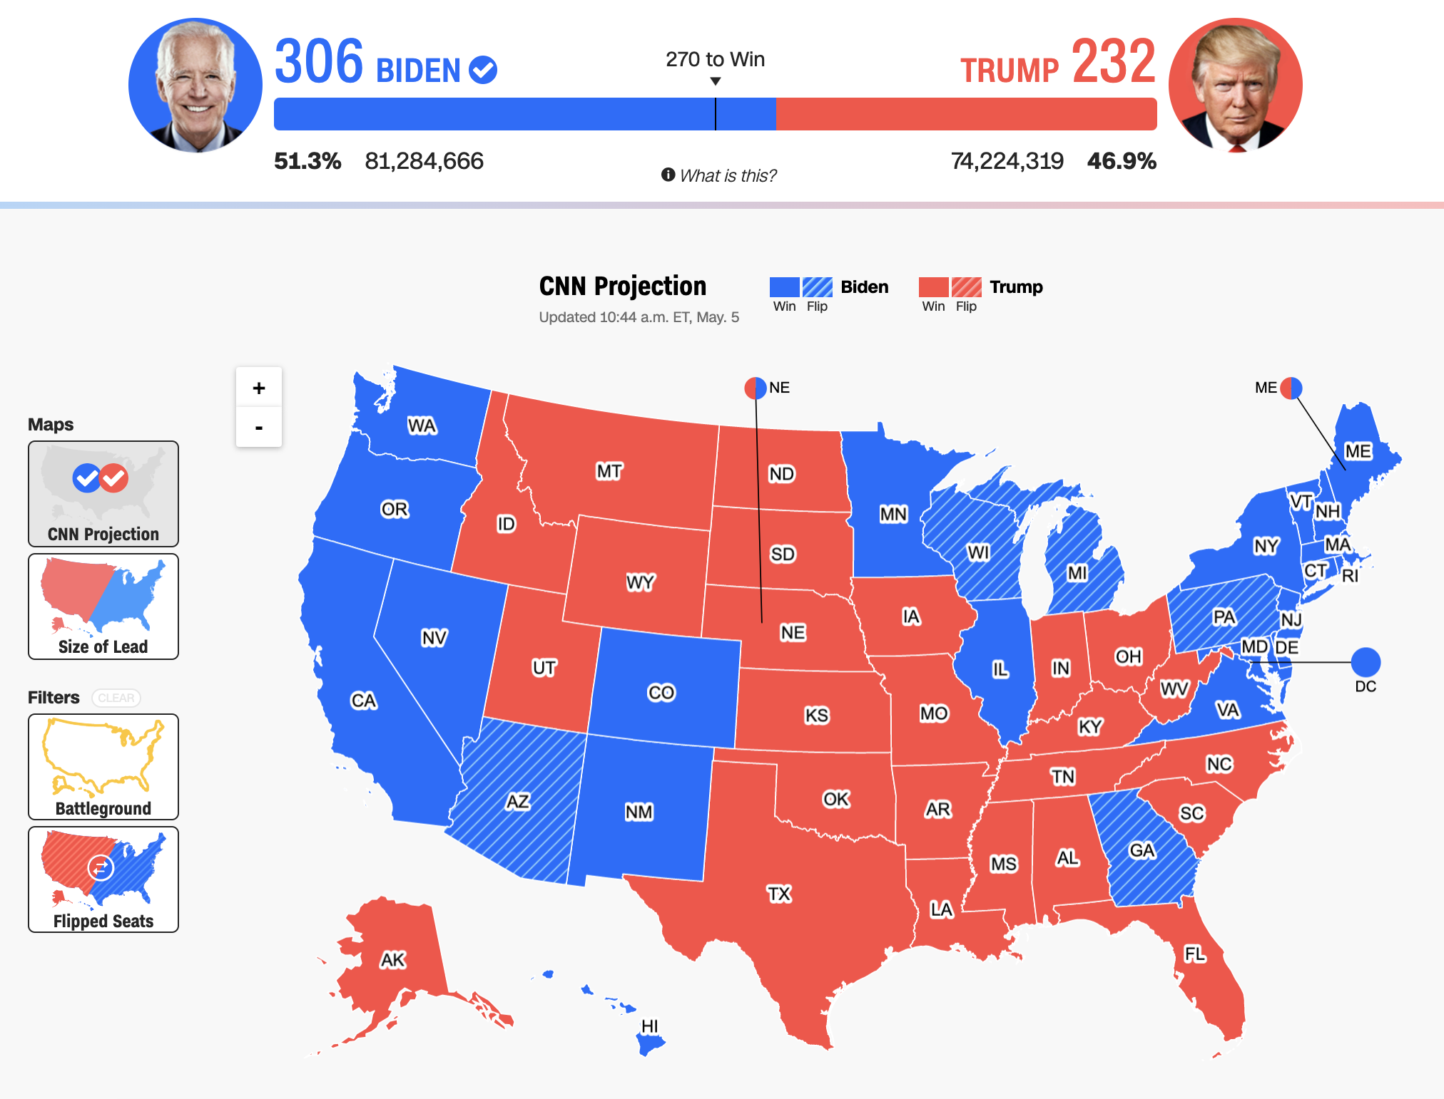
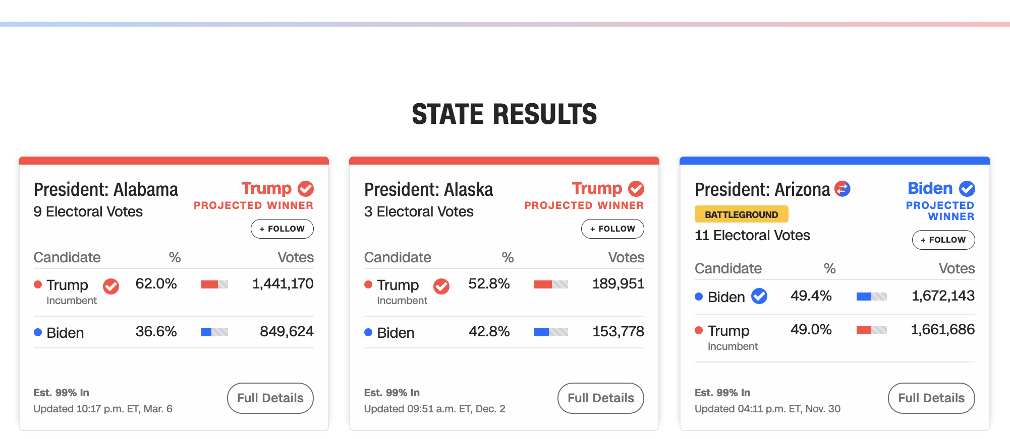

Let’s evaluate this map from CNN with Chartability.
Elavsky et al, “Chartability.” (2022)

Slide 60
POUR+CAF
“I need to pour a cup of coffee to help me consider accessible design!”

Slide 61
Perceivable
Can someone perceive this in multiple ways? Is each way easy?

Slide 62
Perceivable Checklist:
High Contrast
Colorblind-Safe + Redundant Encoding
Alt Text

Slide 63
Design with high contrast
Colorblindness Disproportionately Overrepresented in A11y Resources
Colorblindness Disproportionately Overrepresented in A11y Resources
Colorblindness: % of People
Colorblindness: % of People
4%
4%
Low Vision: % of People
Low Vision: % of People
25%
25%
Colorblindness: # of Resources
Colorblindness: # of Resources
51
51
Low Vision: # of Resources
Low Vision: # of Resources
5
5
Notes:
https://projects.susielu.com/viz-palette

Slide 64
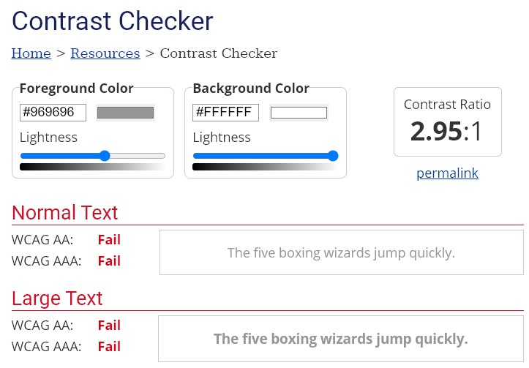
Use High Contrast Text
Text needs at least 4.5:1 contrast against its background.
Large text (bold and 16pt or larger) can be 3:1 or higher.

Slide 65
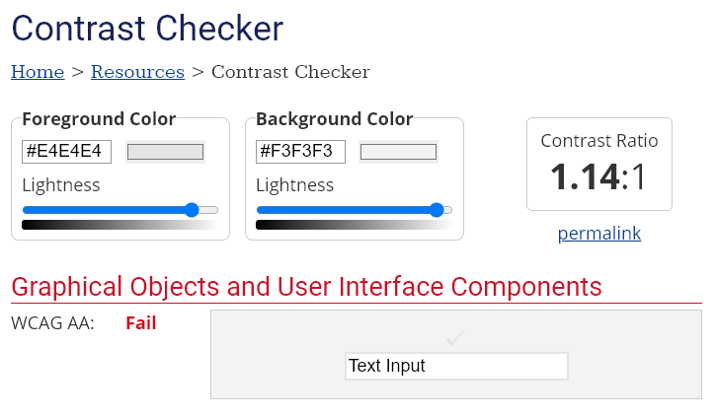
Use High Contrast Geometries
Chart elements need at least 3:1 contrast against their background.

Slide 66
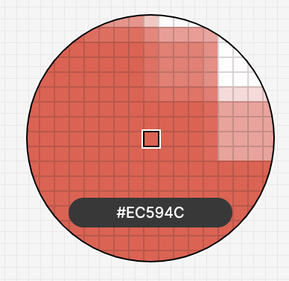
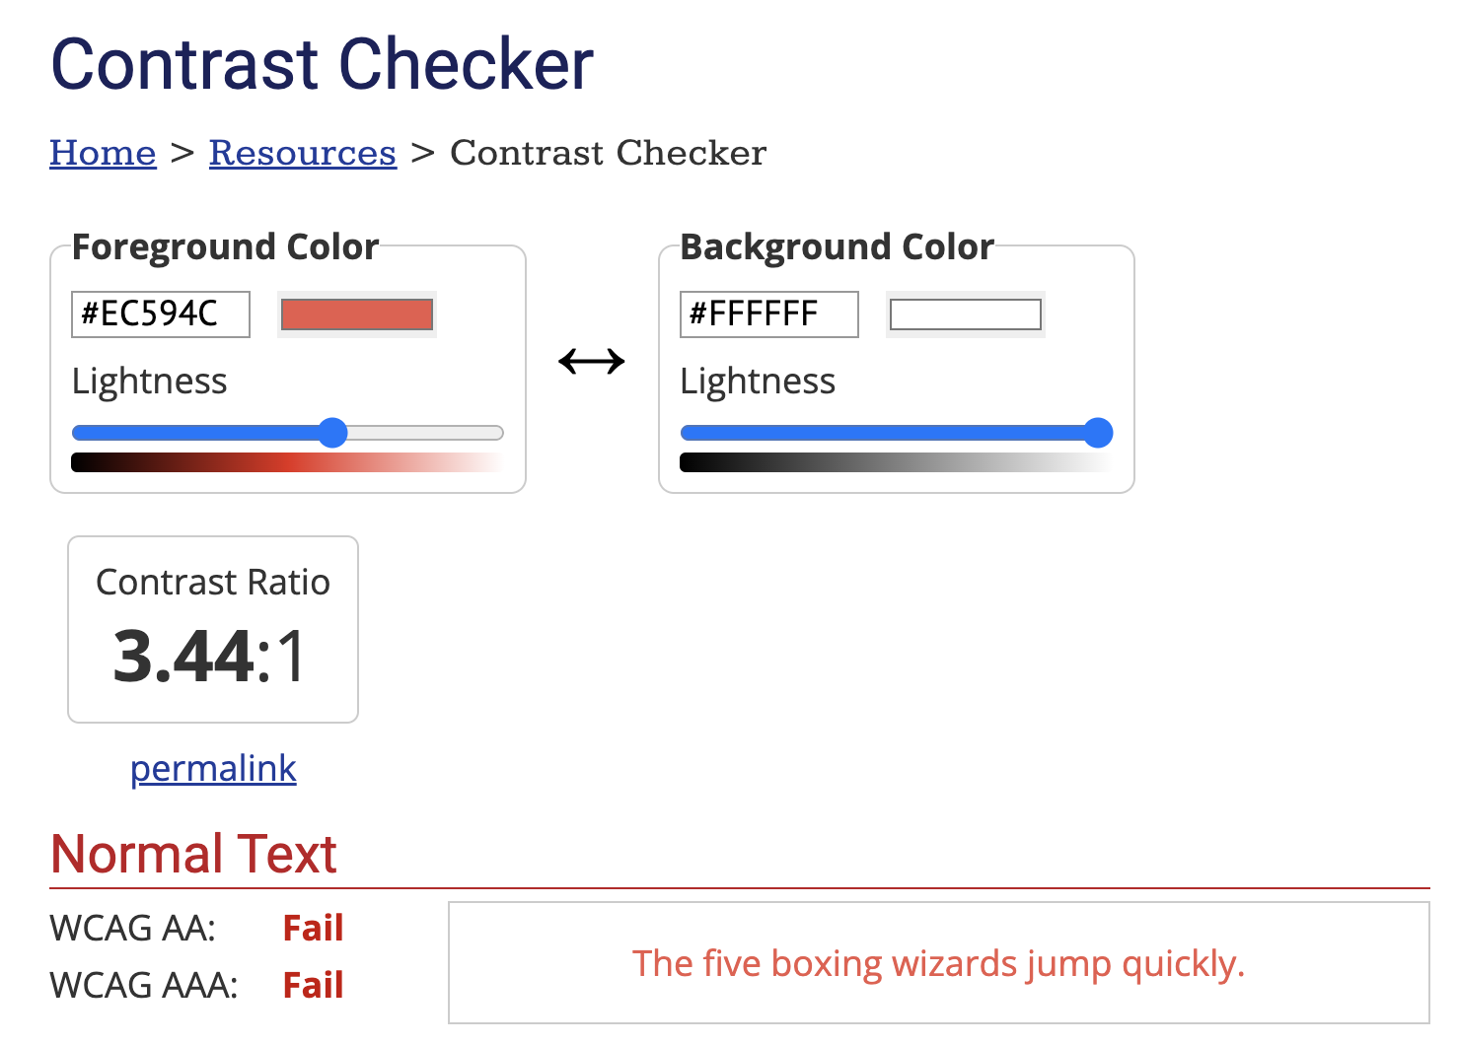


Slide 67
6 instances of low contrast

Slide 68
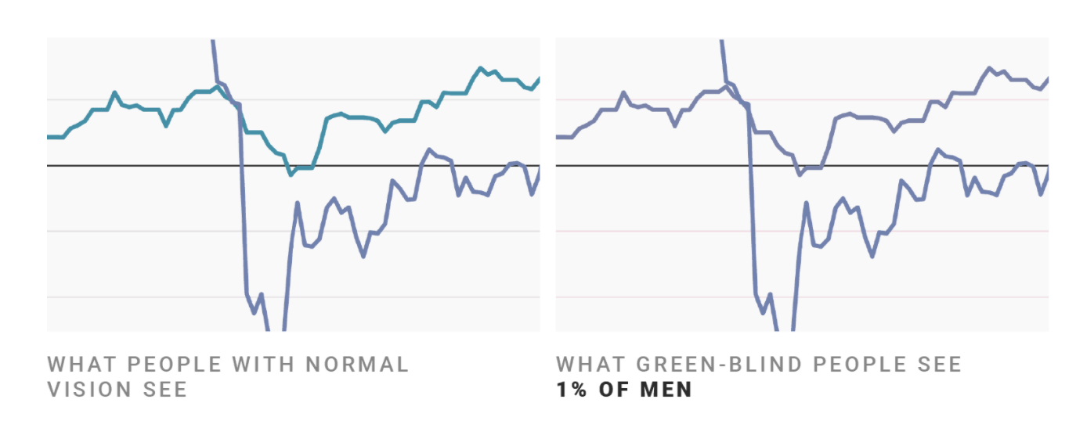
Don’t rely on color alone!
(Muth) https://blog.datawrapper.de/colorblindness-part2/

Slide 69
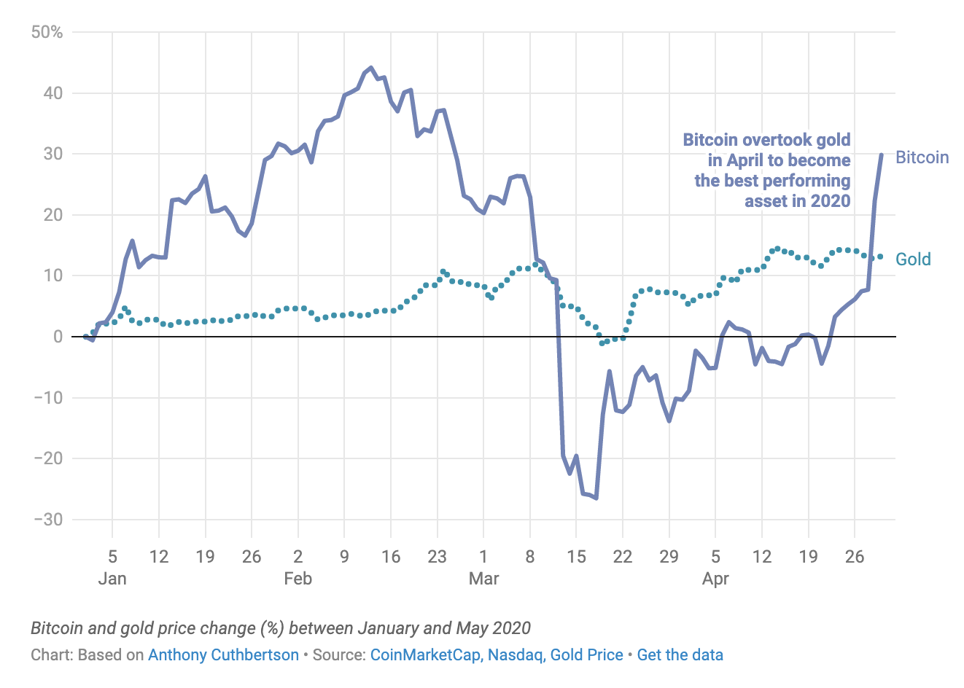
“Redundant encoding” is one strategy

Slide 70
A note: “Color-vision deficiency” and “colorblindness” refer to the same thing, both terms are fine to use.

Slide 71
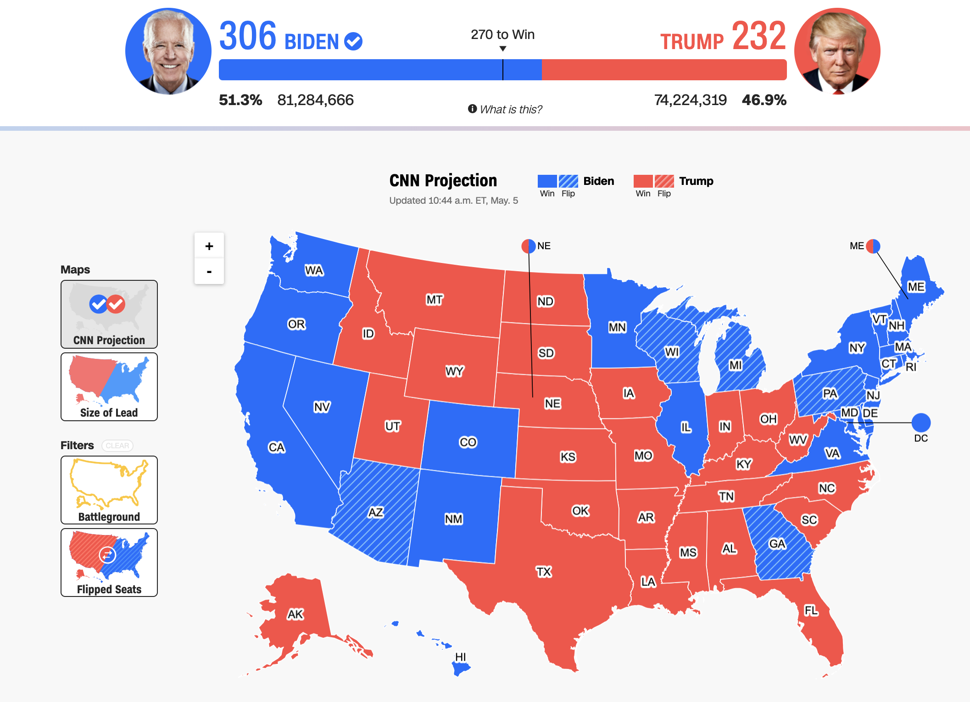
But sometimes you can’t redundantly encode!

Slide 72
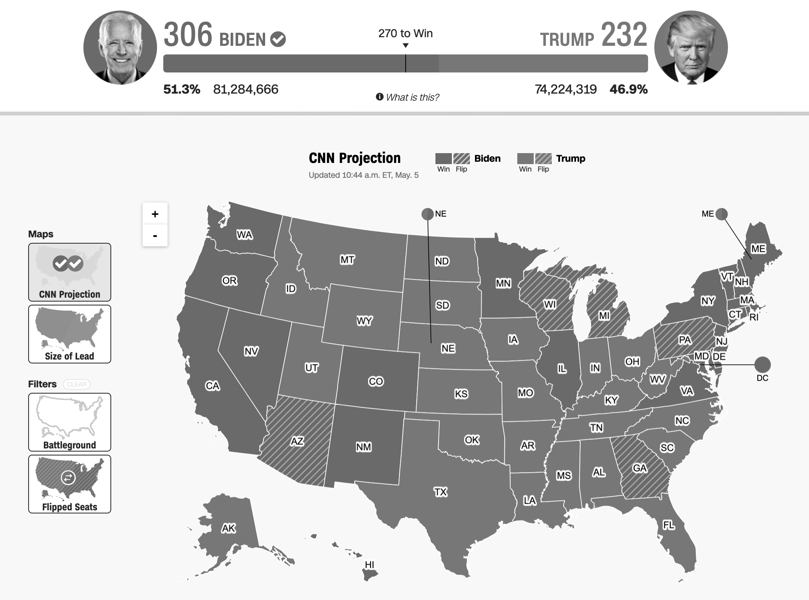
This map is trouble in greyscale

Slide 73
The division here matters!

Slide 74
Maybe a small white divider, like the states?

Slide 75
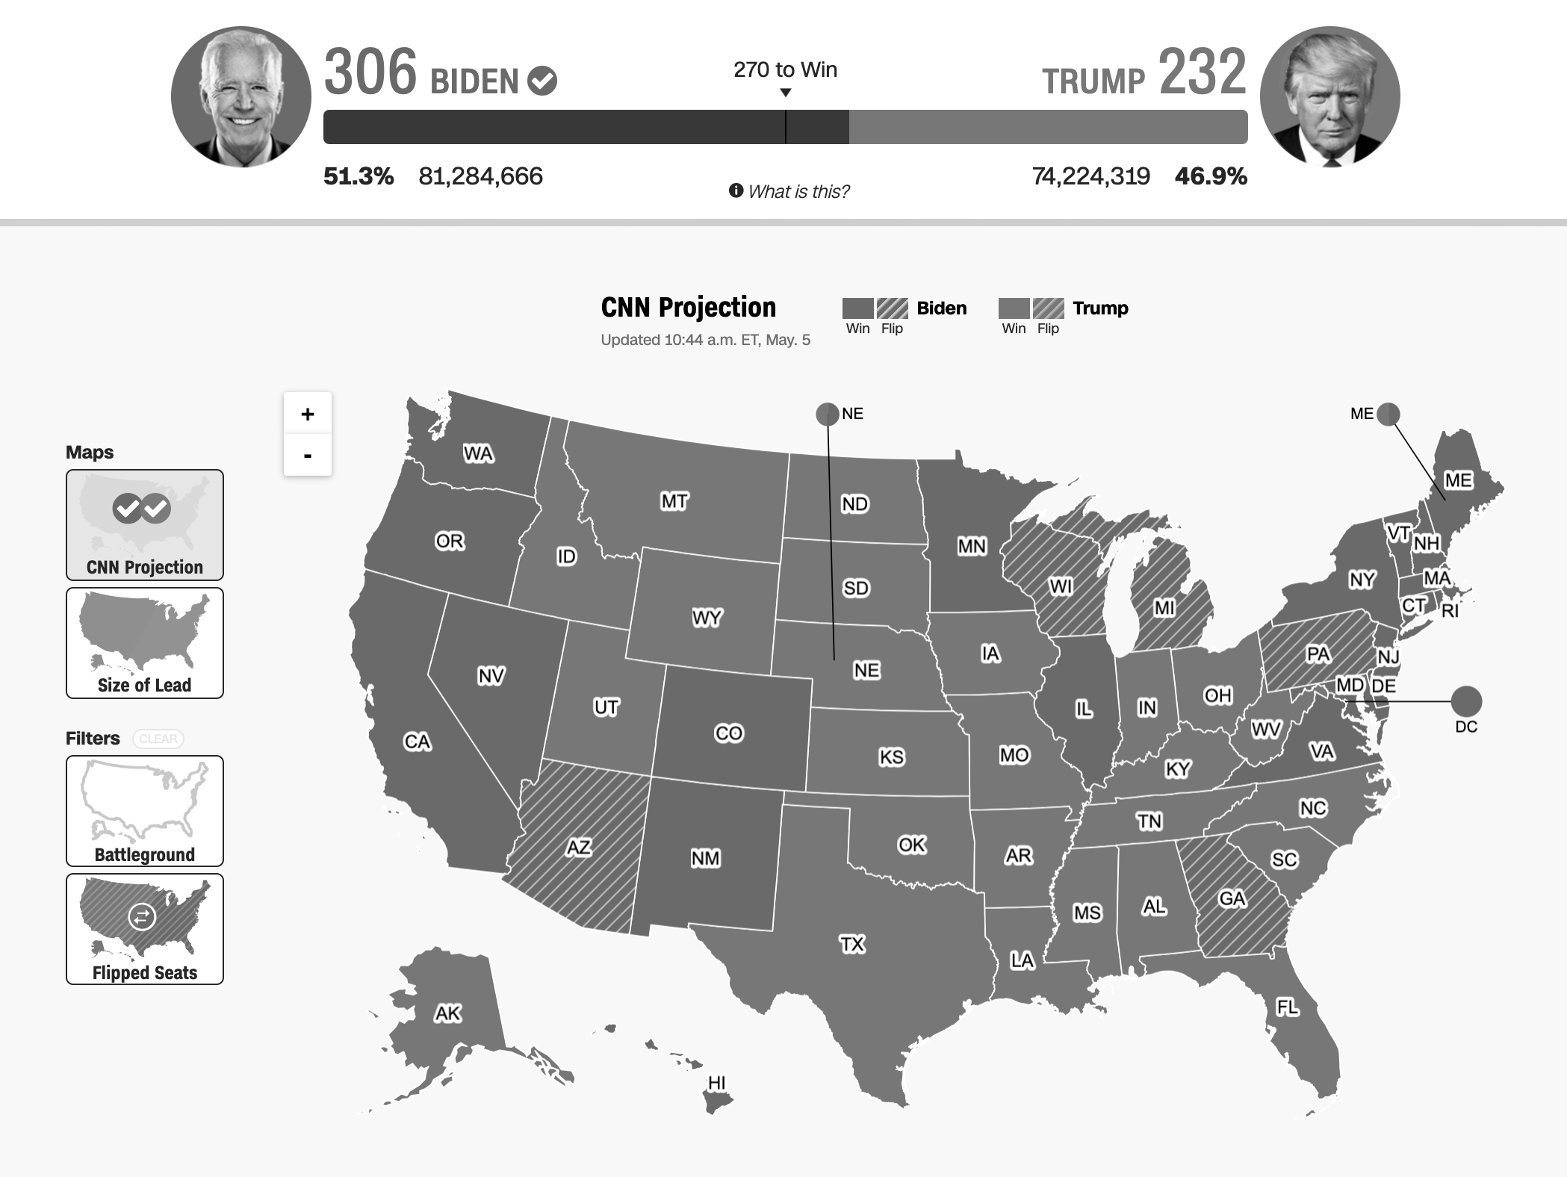
Perhaps test a darker blue too?

Slide 76
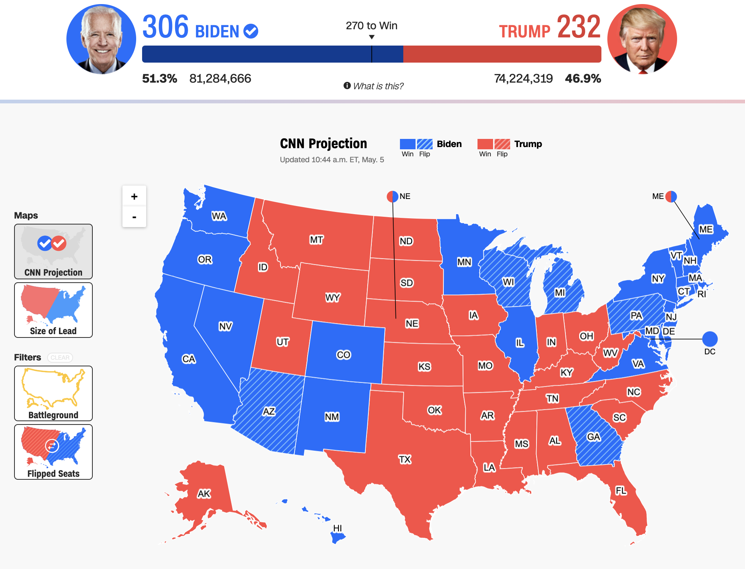
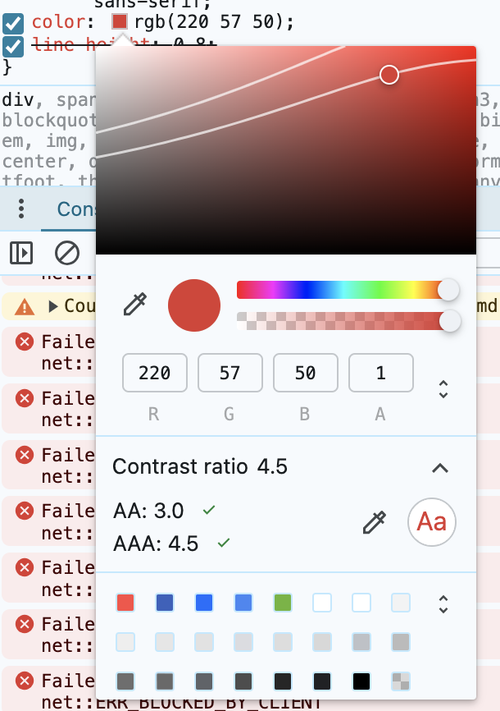
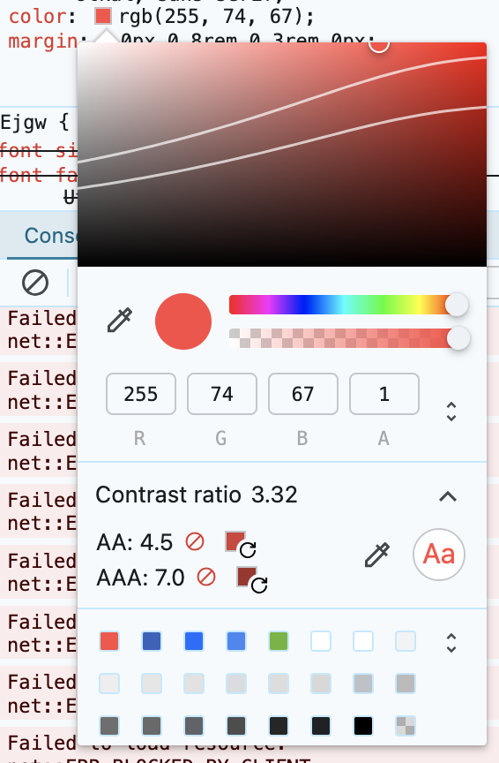
What if we fix the contrast failures at the same time?

Slide 77
This text now passes!

Slide 78
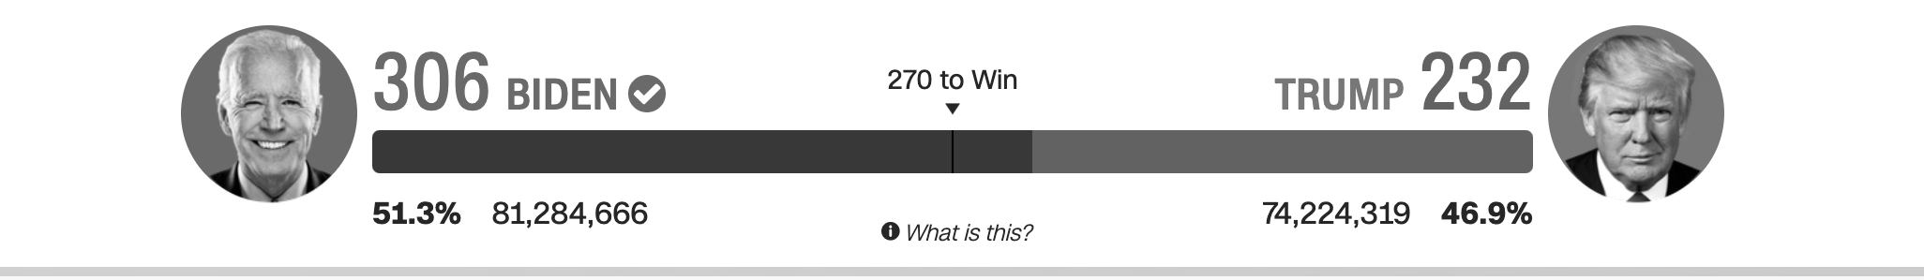
Let’s check that greyscale again…

Slide 79
Before

Slide 80
And after!

Slide 81
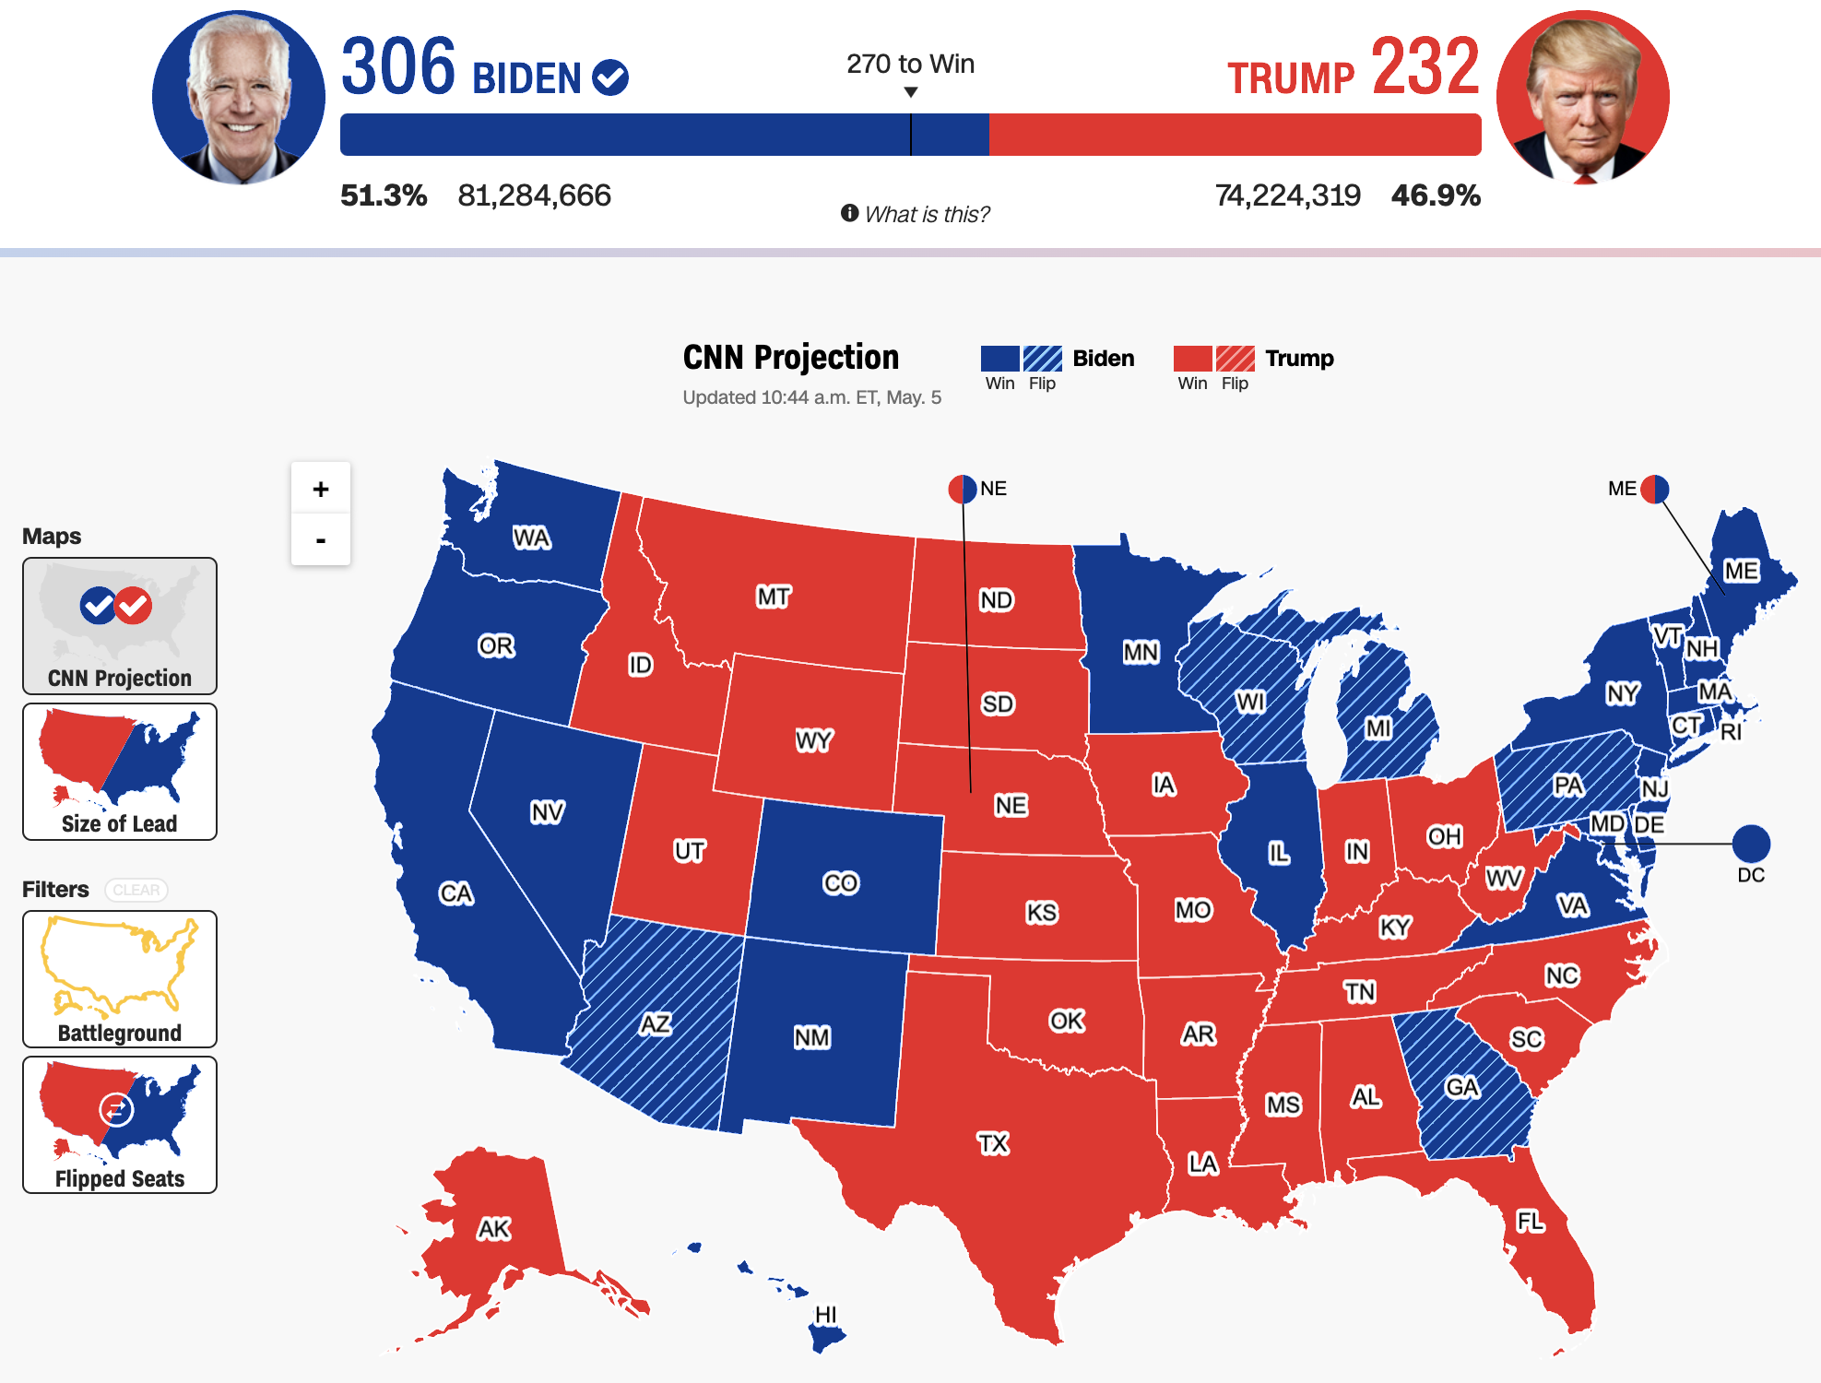
Sufficient contrast can help folks differentiate

Slide 82
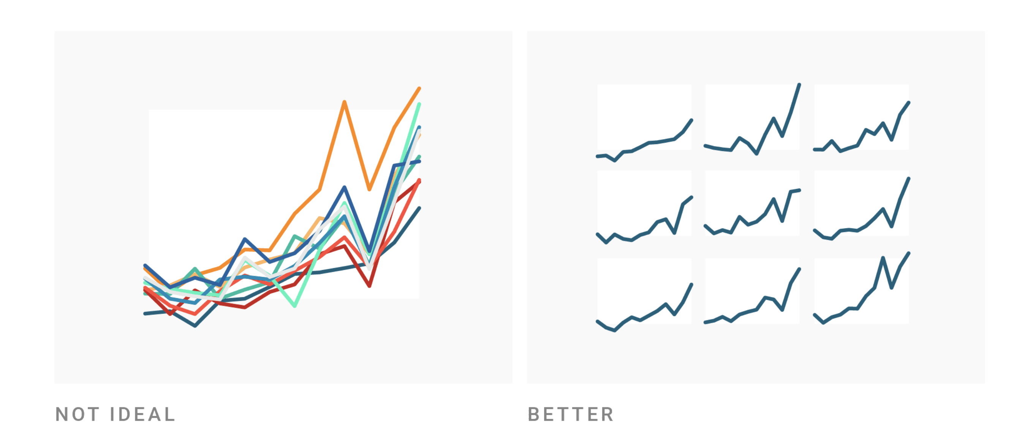
But what about more than 2 colors?
Source: Datawrapper

Slide 83
But what about more than 2 colors?
Finding “pair” contrast gets really hard after 3+ colors…
Source: Datawrapper

Slide 84
Reduce your colors and redesign!
Source: Datawrapper

Slide 85
Reduce your colors and redesign!
Using “small multiples” is an easy, powerful technique
Source: Datawrapper

Slide 86
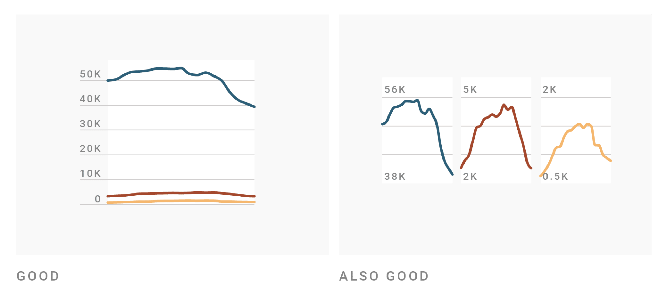
Or simply separate your colors, if they matter
Source: Datawrapper

Slide 87
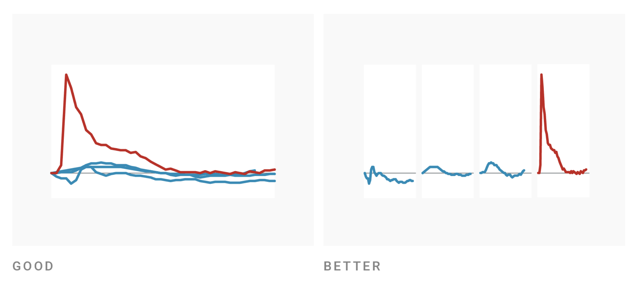
My favorite use of color is to pick just one for emphasis
Source: Datawrapper

Slide 88
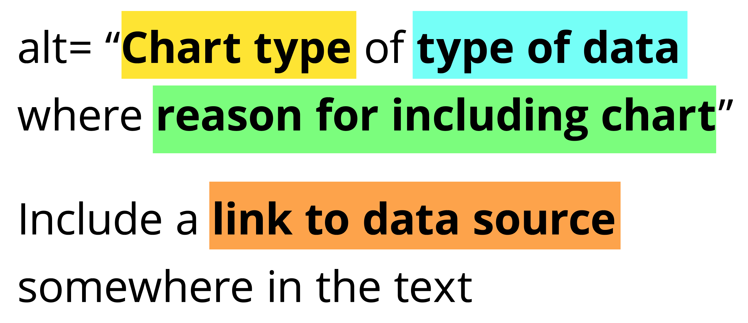
Add alt text
There is great research on alt text, but the most important thing to know is that you should add it to every image you post online (including twitter), in a document, or presentation.
Guidance: https://medium.com/nightingale/writing-alt-text-for-data-visualization-2a218ef43f81

Slide 89
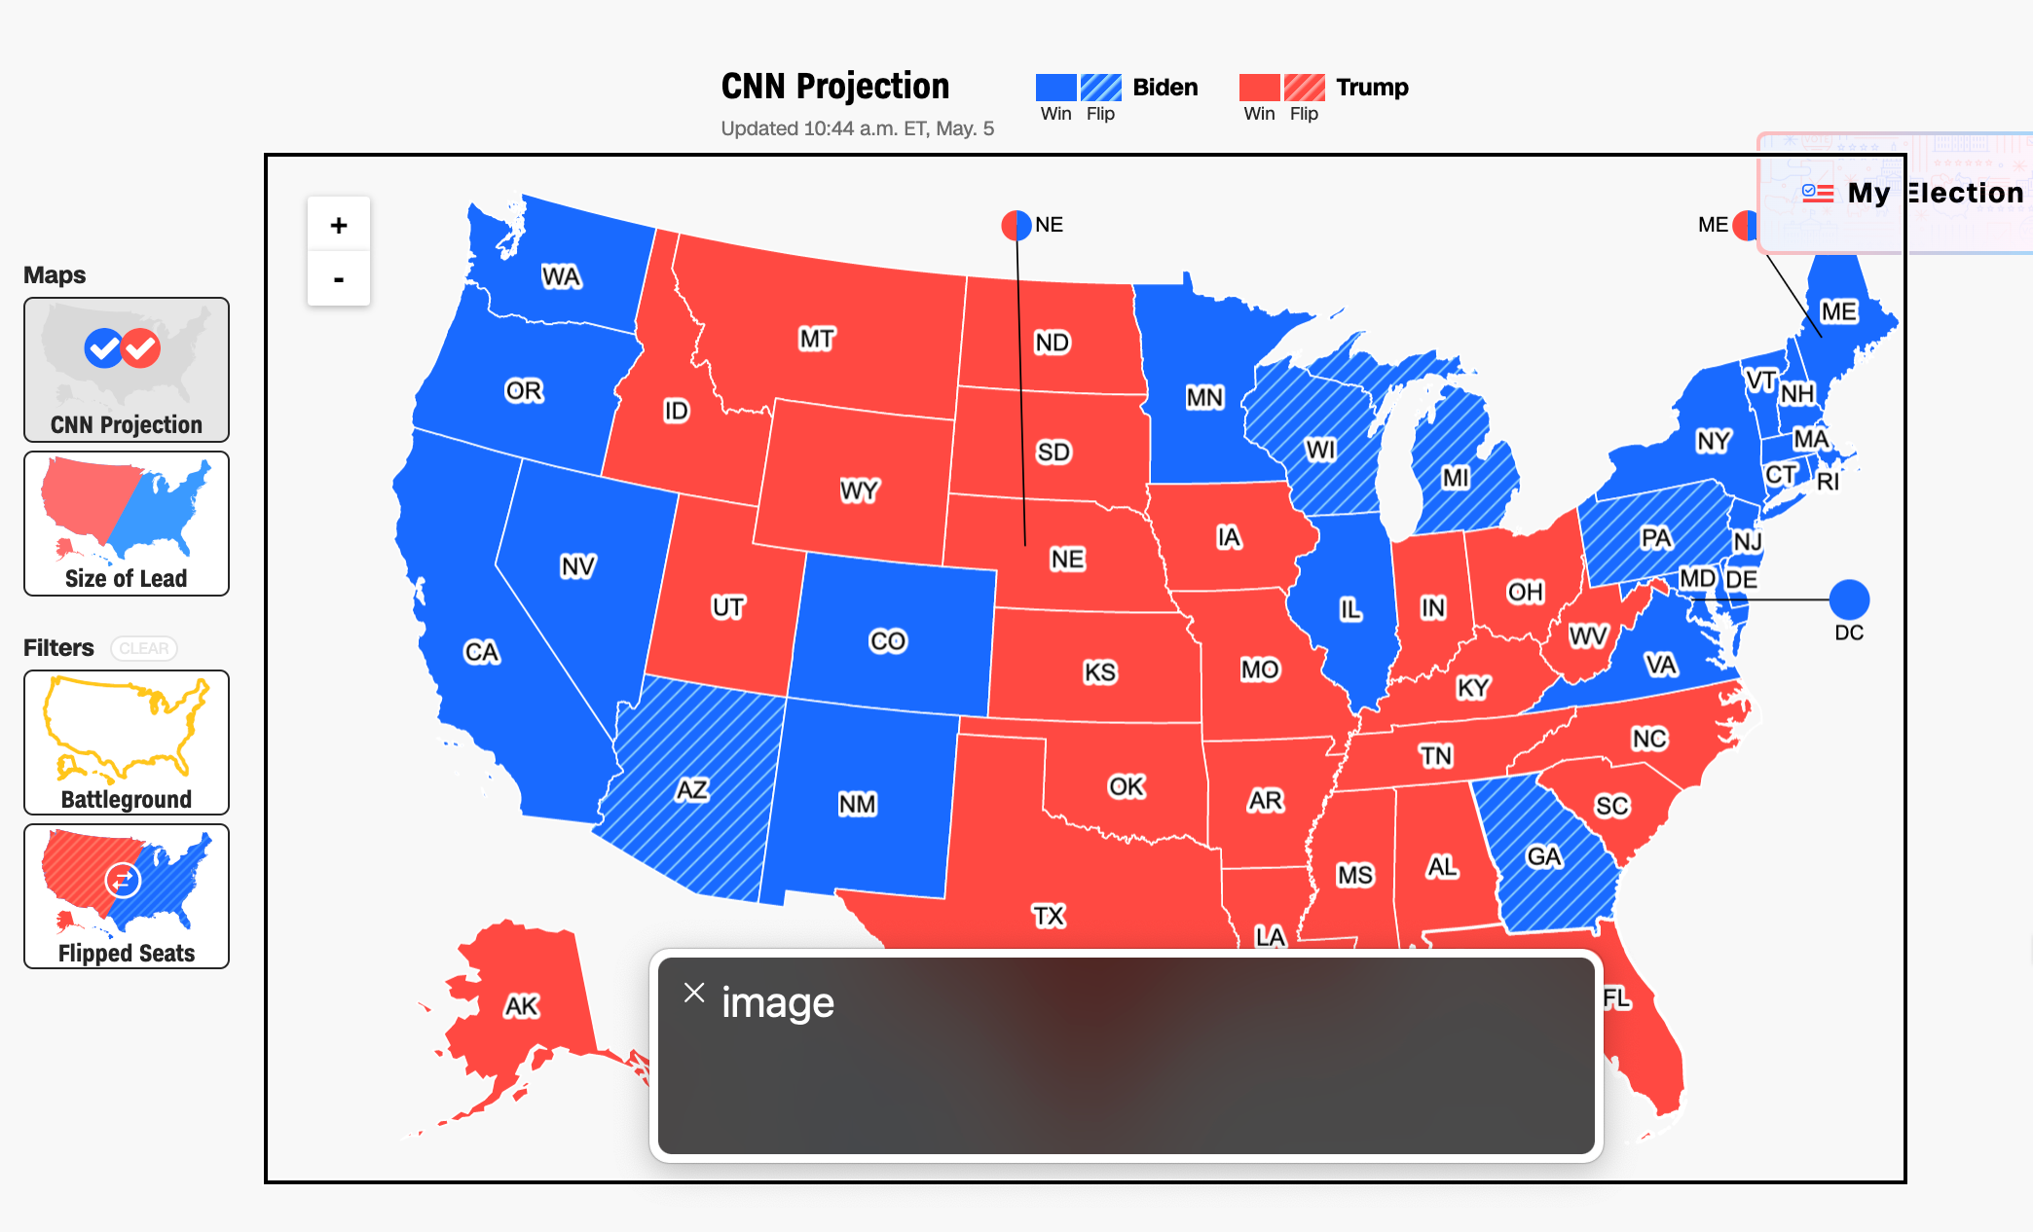
57 instances of “Content is only visual”

Slide 90
Each state should announce to screen readers what state it is and who won it, not “image!”

Slide 91
Recap: Perceivability
Use high contrast
Use redundant encoding
Reduce colors and crowding
Add alt text

Slide 92
Perceivable Evaluation Toolkit:
Contrast Checker
Safe color design
CVD Checker
Redundant encoding design ideas
Small multiples design ideas
Alt Text

Slide 93
Question for Frank

Slide 94
Operable
Can someone operate this in multiple ways? Is each way easy?

Slide 95
Operable Checklist:
Mouse
Keyboard-only
Screen Reader

Slide 96
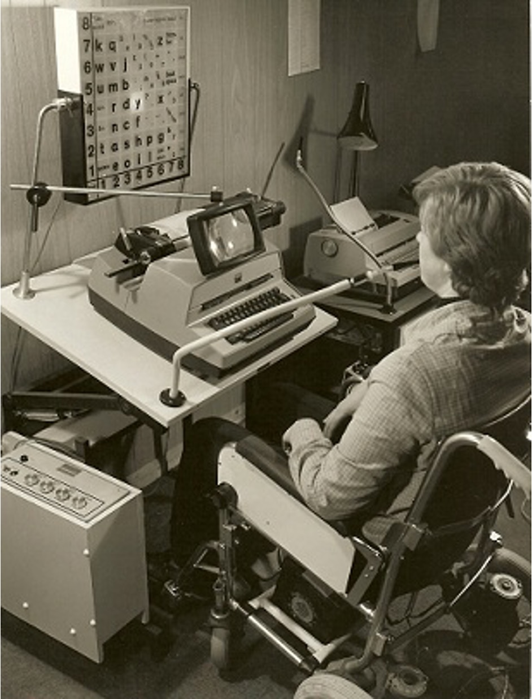
Many assistive input technologies “navigate”
A person in a wheelchair operating an old computer using a desk-mounted sip and puff device called the POSSUM.
Image credit: Wikipedia, Public Domain, 1960. Photographer: Possum Ltd.
Notes:
Mouse and touch, called direct pointers, rule all. They dominate interaction assumptions and paradigms in computing and especially visualization. But many, many assistive technologies actually navigate content instead. And these have been around since the early days of computing. Shown here is a person in a wheelchair in 1960 operating an computer using a sip and puff device, which uses their breath to control a computer.
Sip and puffs are still used today!

Slide 97
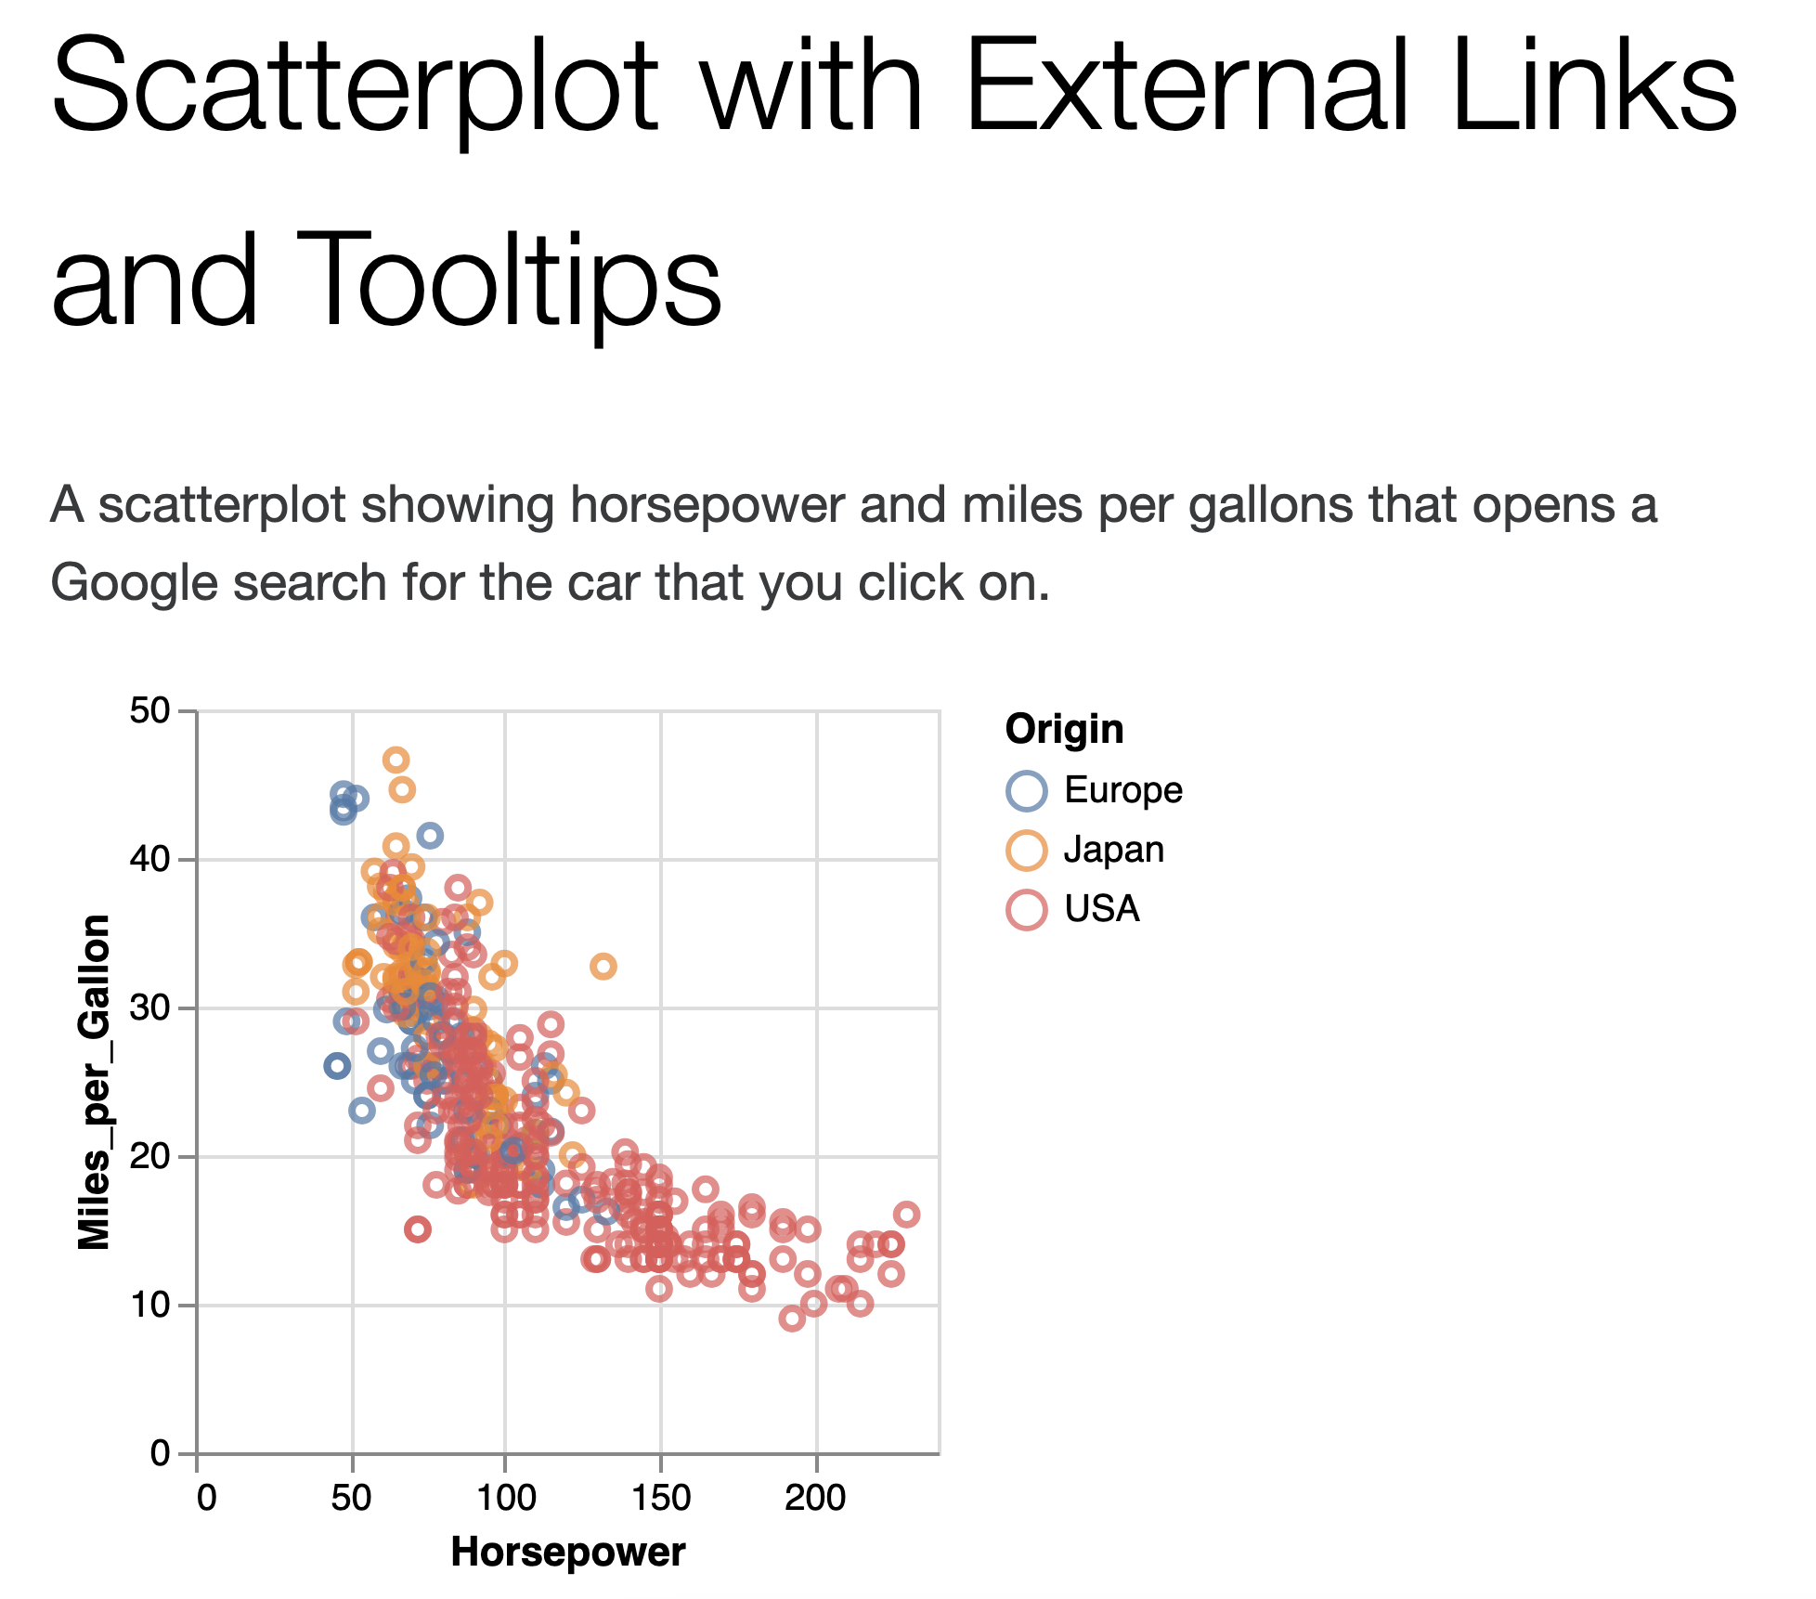
Why “keyboard-only?”
Some things work for screen readers but not for keyboard-only users!
https://vega.github.io/vega-lite/examples/point_href.html

Slide 98
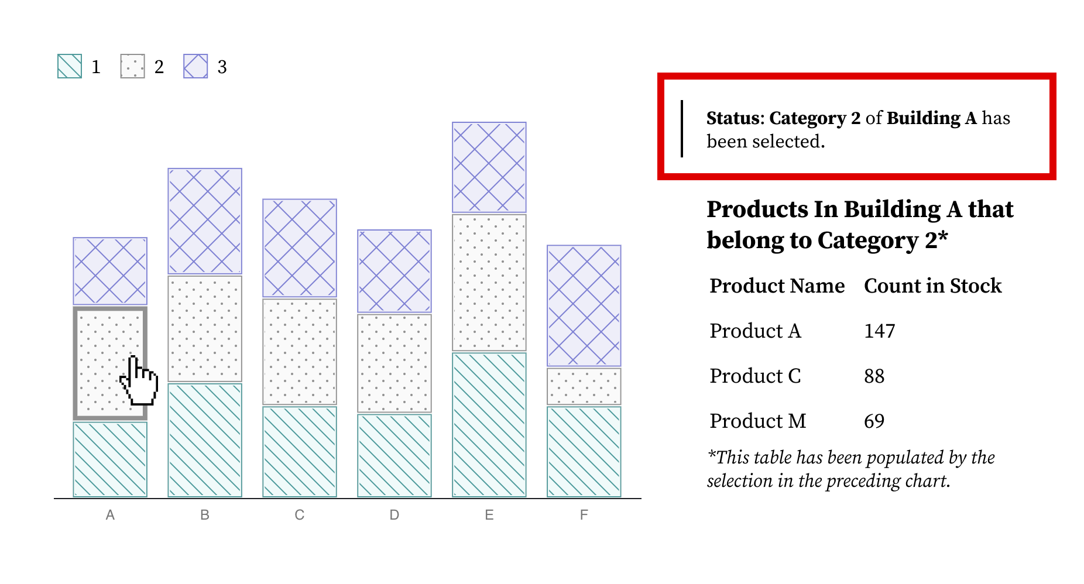
Ensure Keyboard Access (if interactive)

Slide 99
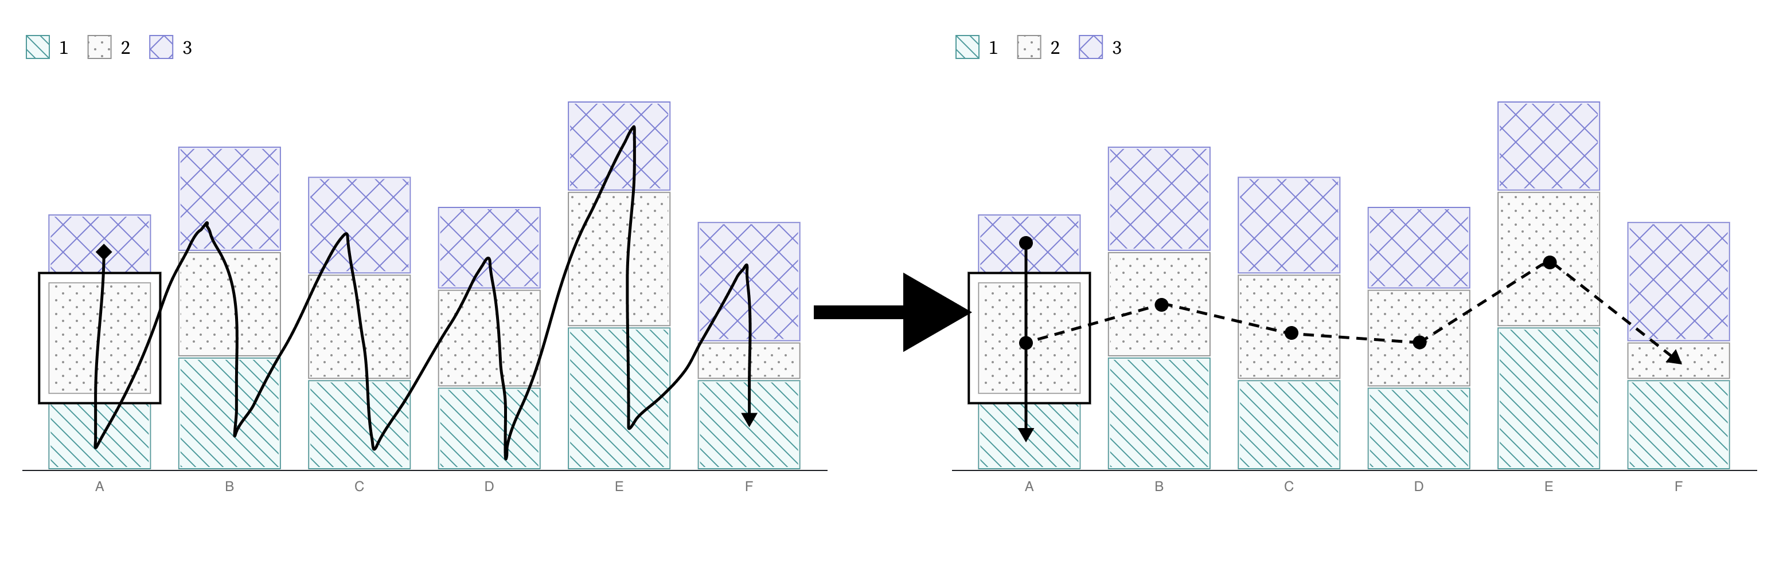
How does someone move around? By default, it is as elements are rendered:

Slide 100
Consider more flexible movement when data exploration matters

Slide 101
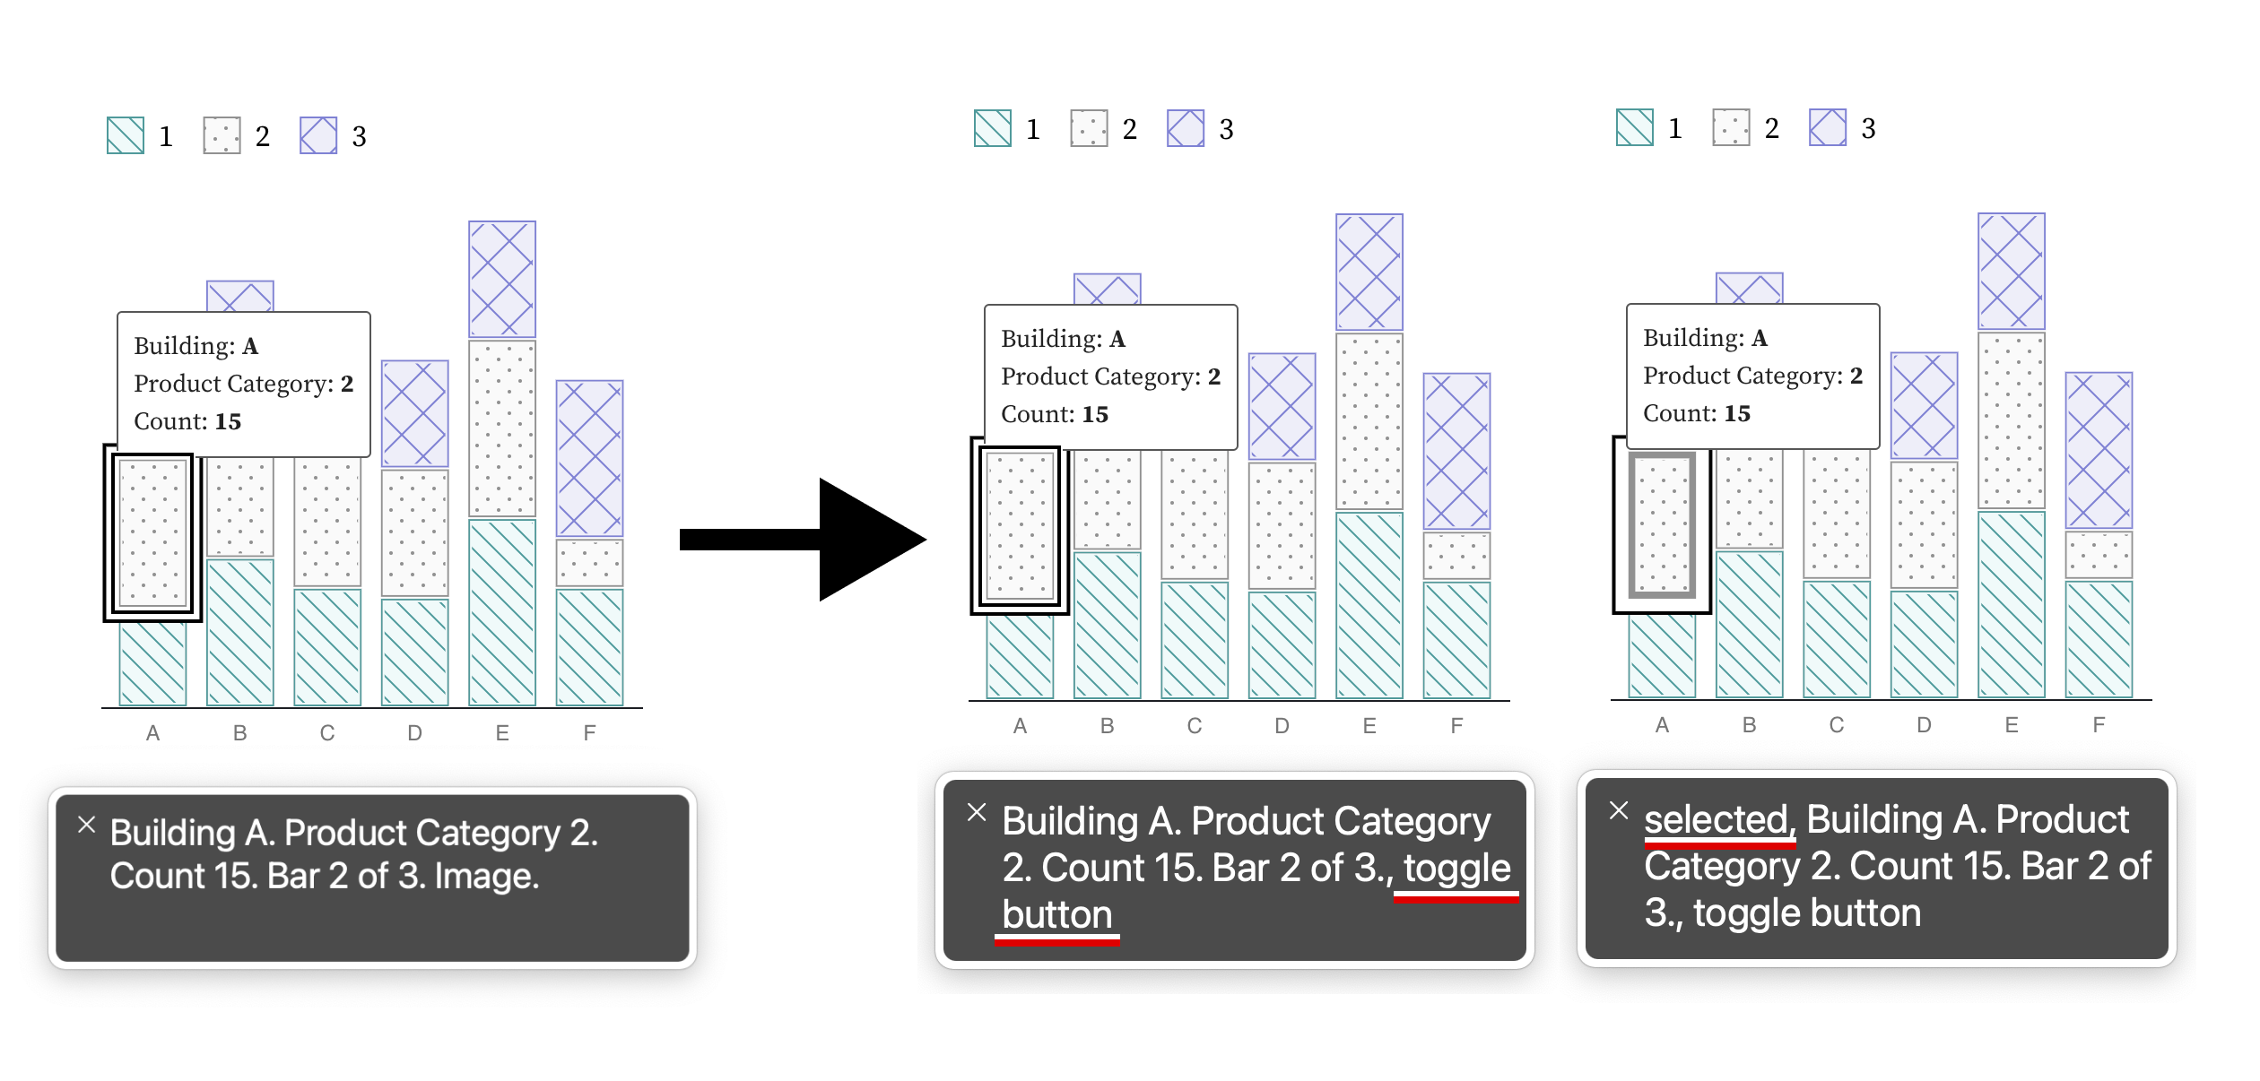
Alt text should communicate operability

Slide 102
Semantics matter
“Image” doesn’t signal interactivity!

Slide 103
“Aria” states and roles are standardized

Slide 104
Communicating operability should be visual too
Hovered/focused
Selected

Slide 105
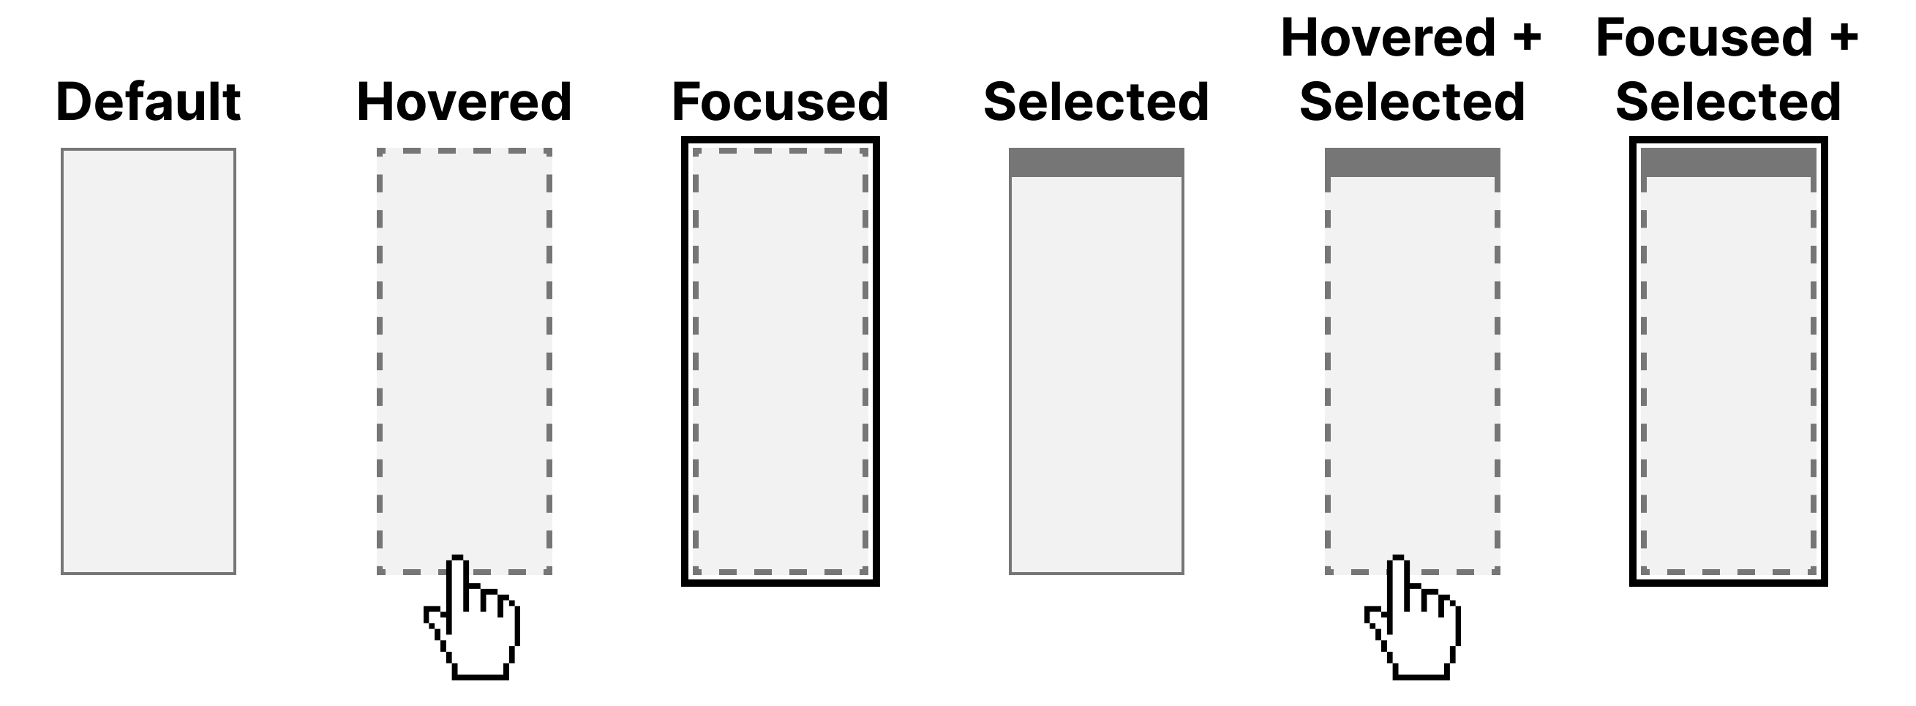

Design your own interaction styling

Slide 106
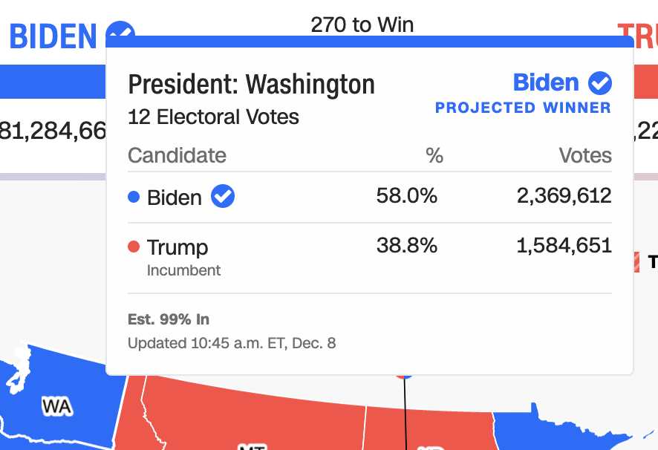
54 instances of “only one input type”

Slide 107
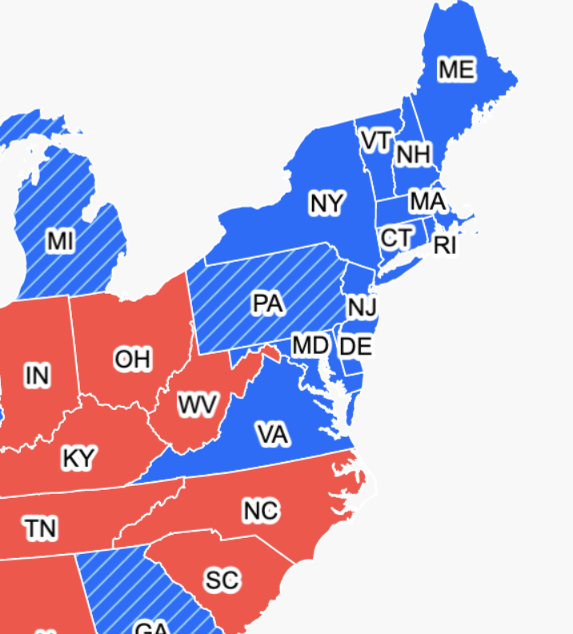


Expecting users to hover on something tiny is an accessibility design failure

Slide 108
18 instances of “target pointer size is too small”

Slide 109
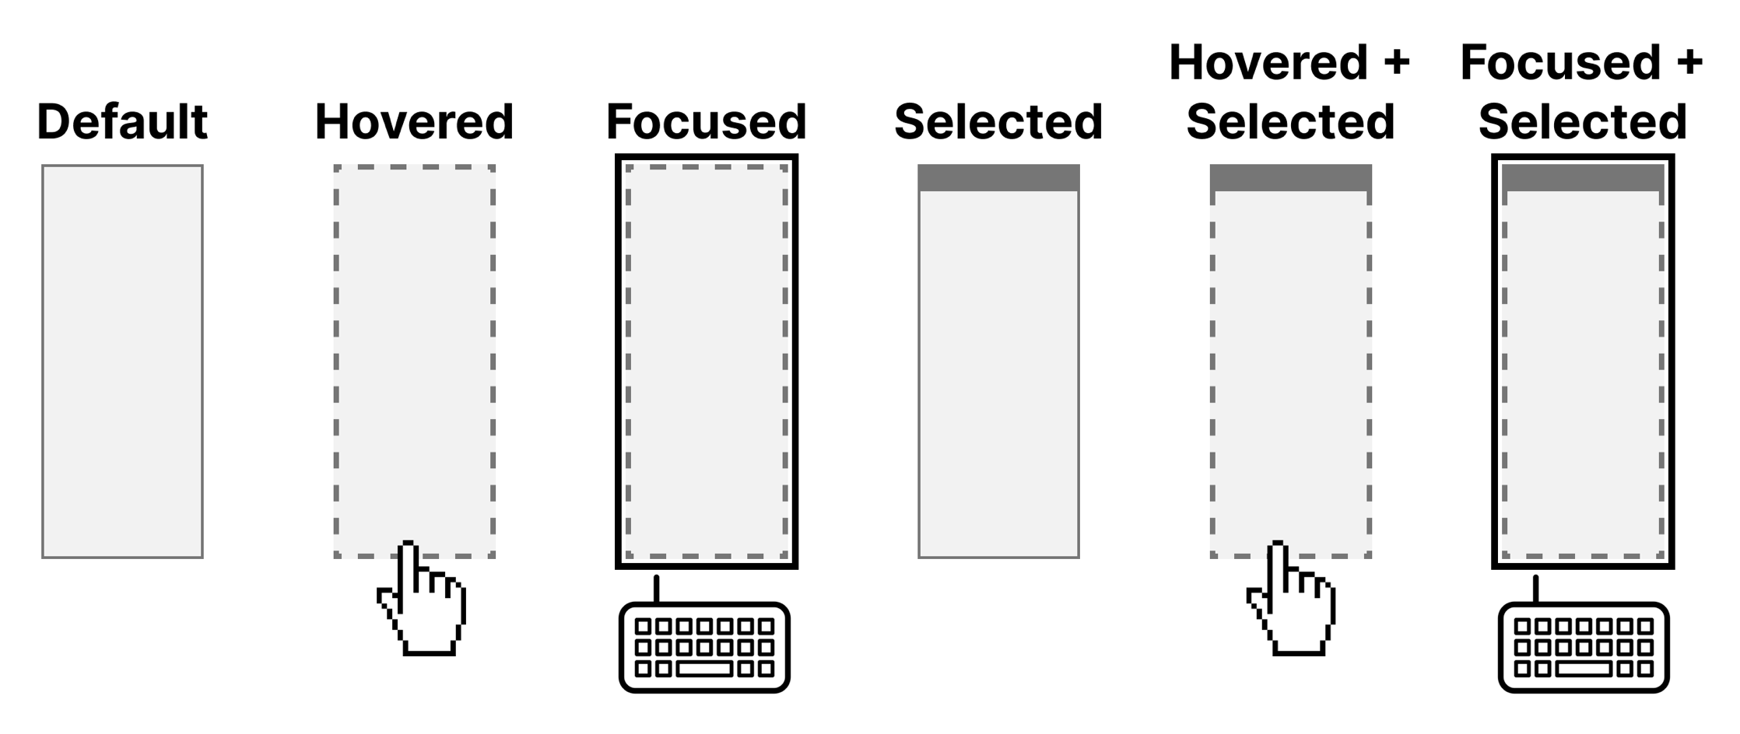
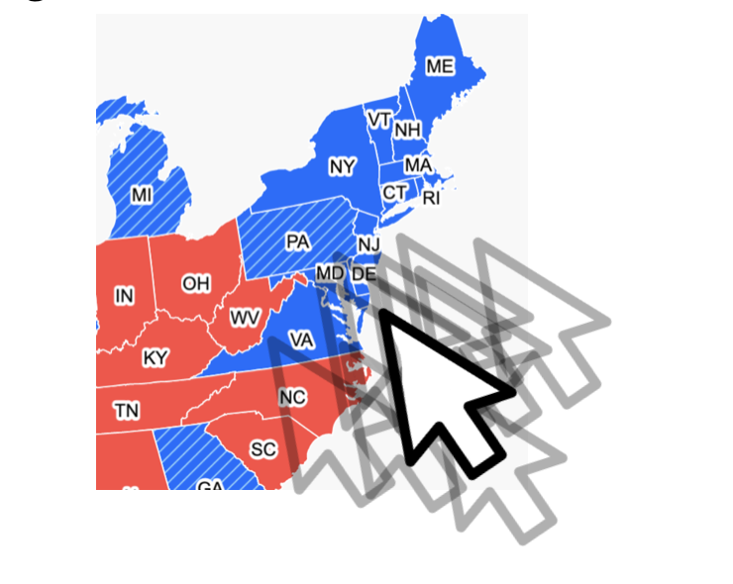
Recap: Operability
Consider how someone navigates
Describe the functionality of elements
Communicate interaction state visually
Improve the size of interaction areas

Slide 110
Operable Evaluation Toolkit:
Use your mouse: can it do something meaningful? (tooltip, click event, etc) If so:
Test using a keyboard-only: can you navigate and use keyboard activation (spacebar/enter) on the visualization?
Test using a screen reader: Can you use a screen reader to navigate and use keyboard activation on the visualization?
Check sizes: can a mouse easily interact with this?

Slide 111
Question for Frank

Slide 112
Understandable
Can someone understand this in multiple ways? Is each way easy?

Slide 113
Understandable Checklist:
Descriptive title, summary, or caption
Data table or data download
Reading level

Slide 114
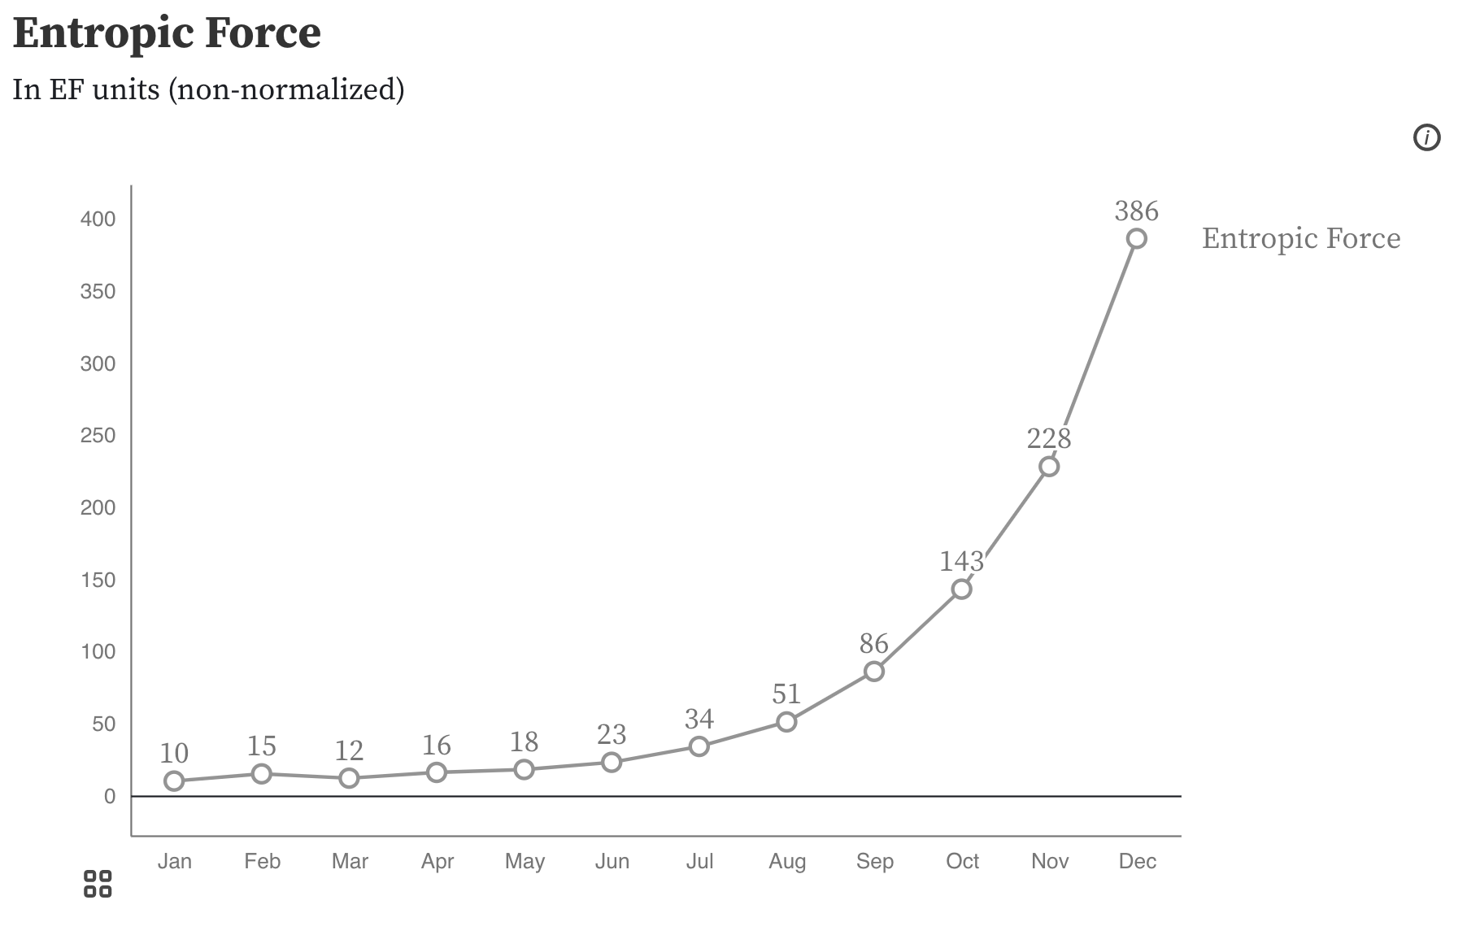
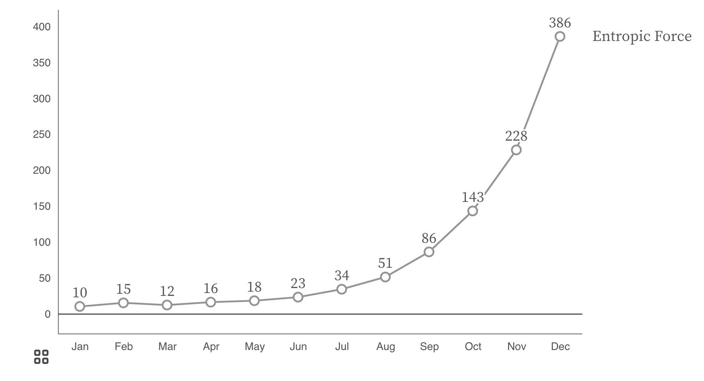
Non-descriptive titles are inaccessible

Slide 115
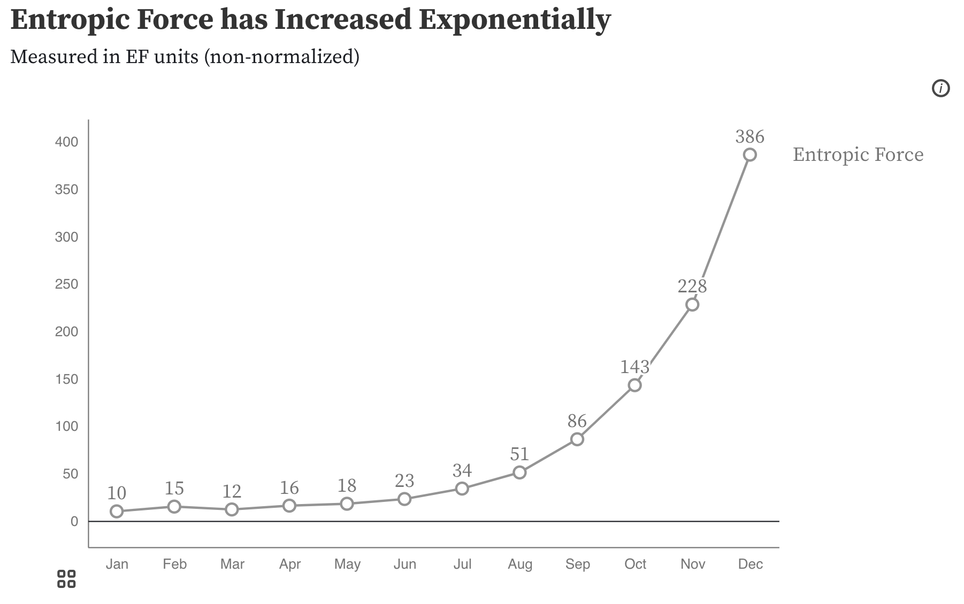
Descriptive titles have summaries/takeaways

Slide 116
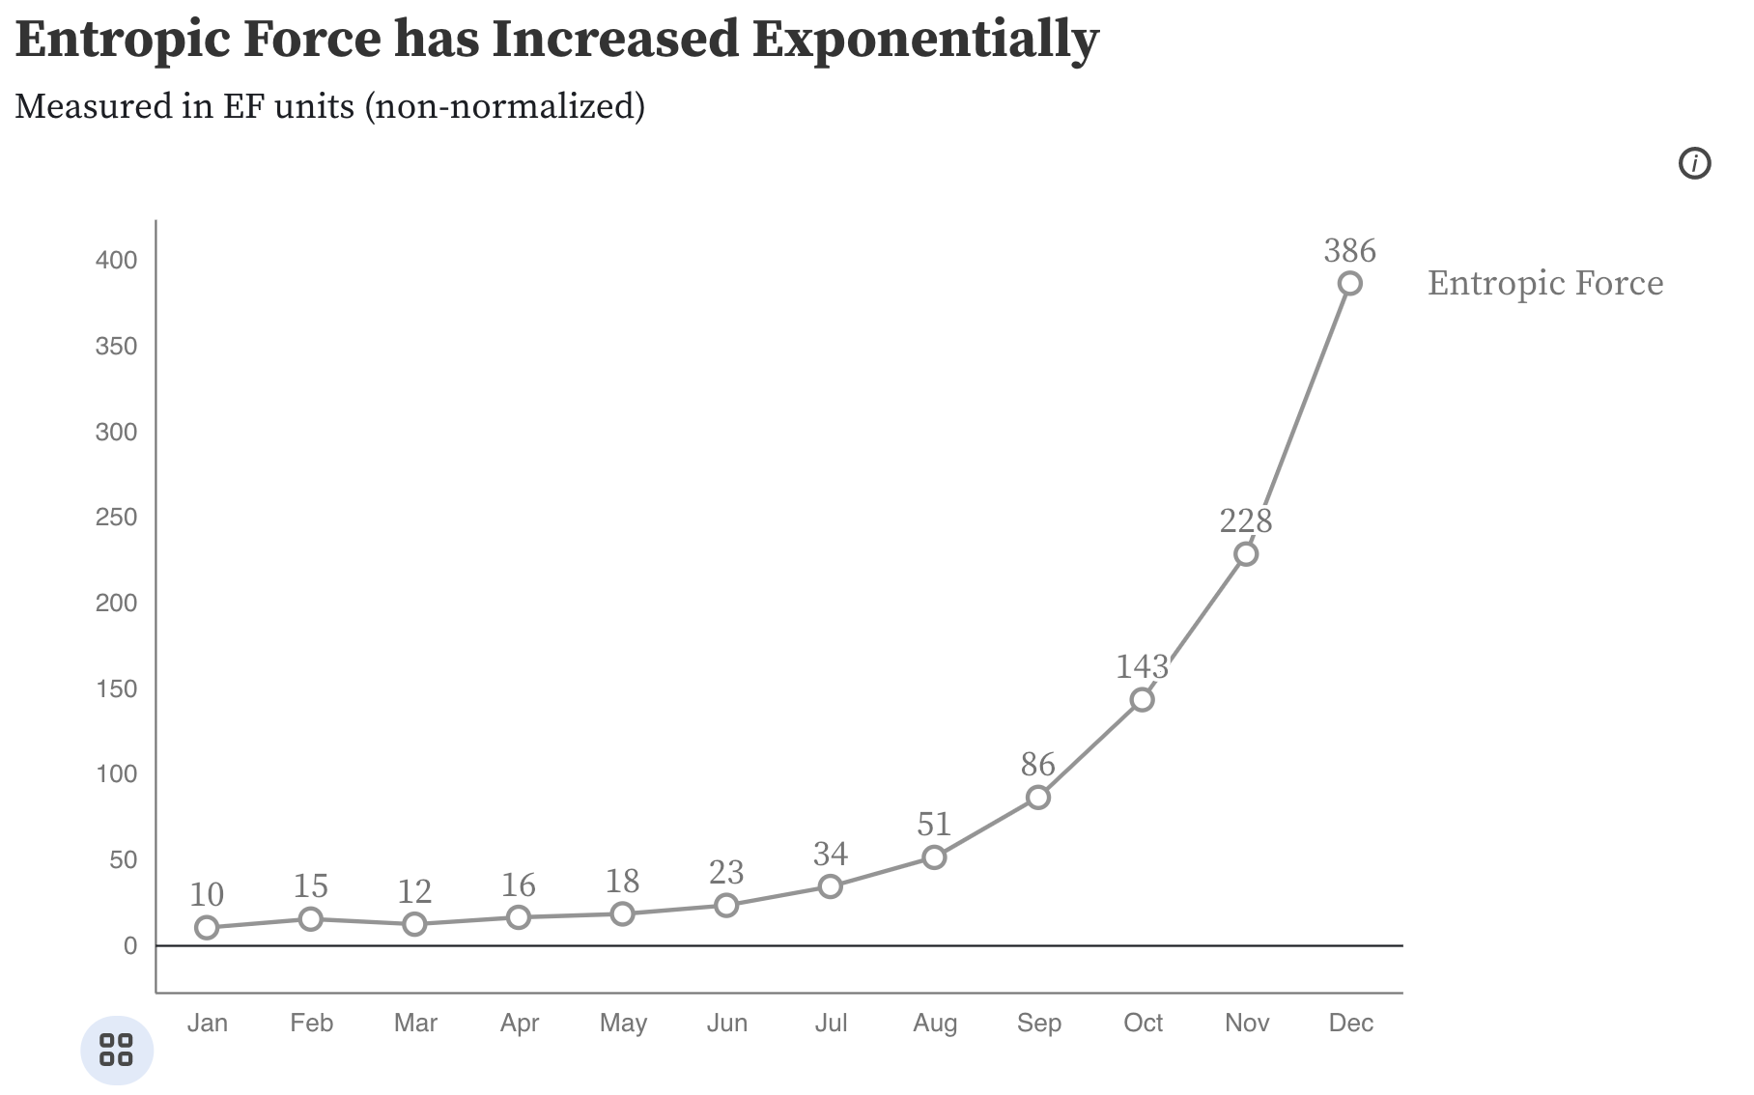
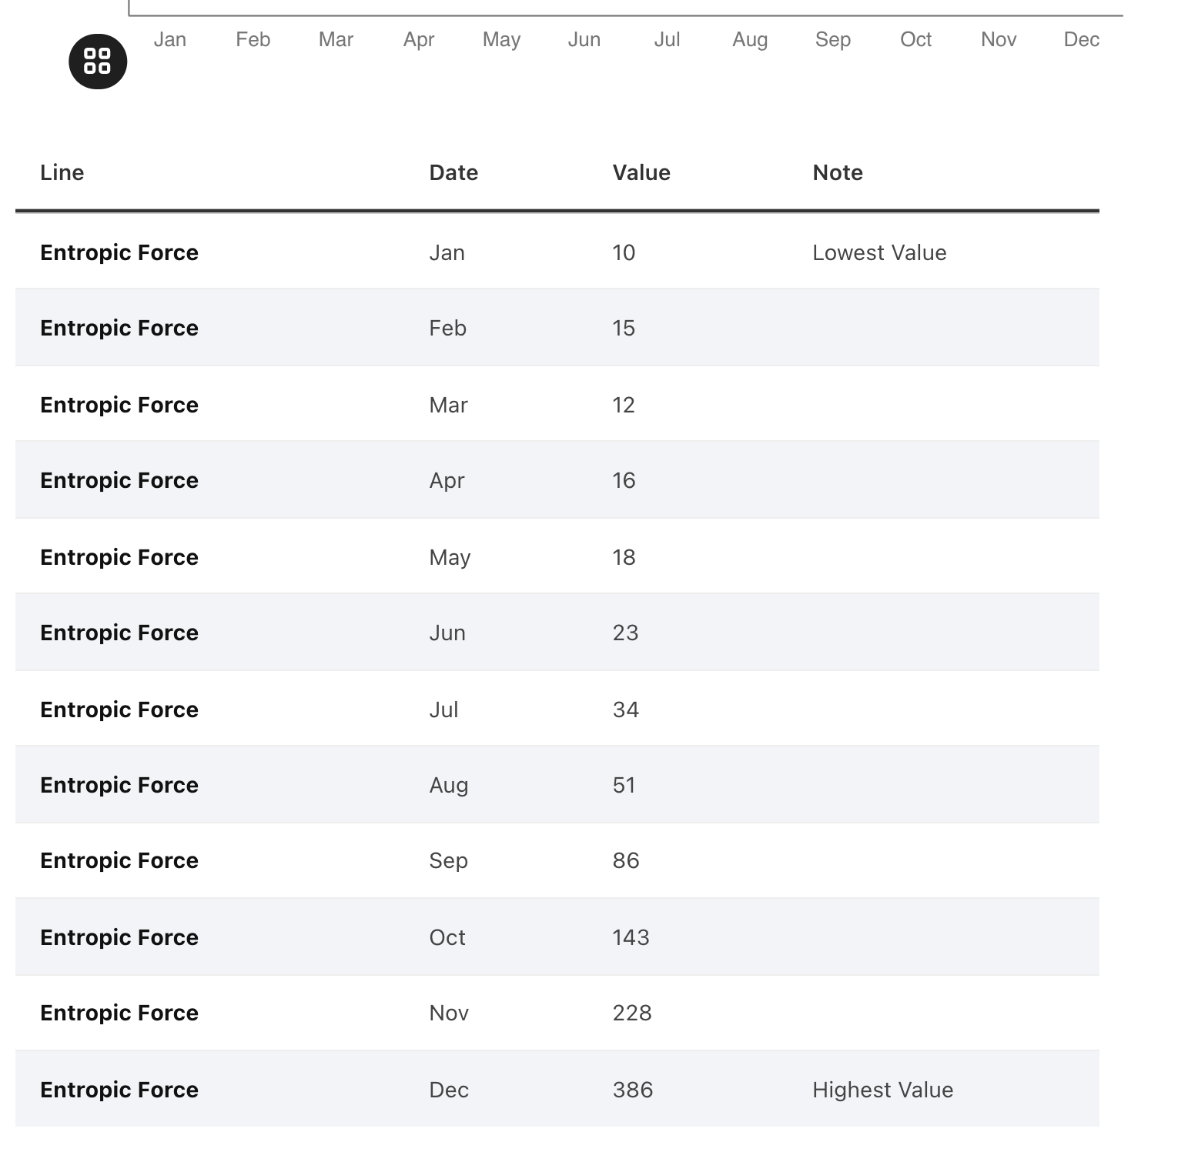
All charts should have data available!

Slide 117
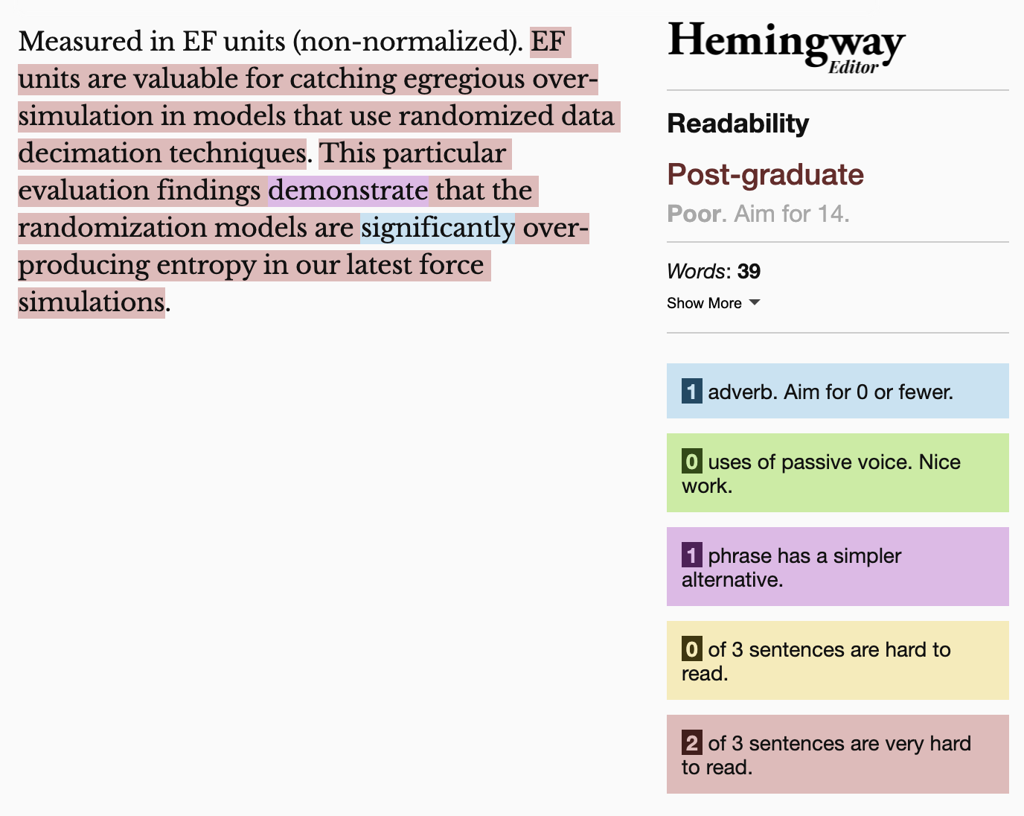
Technical language is often overkill

Slide 118
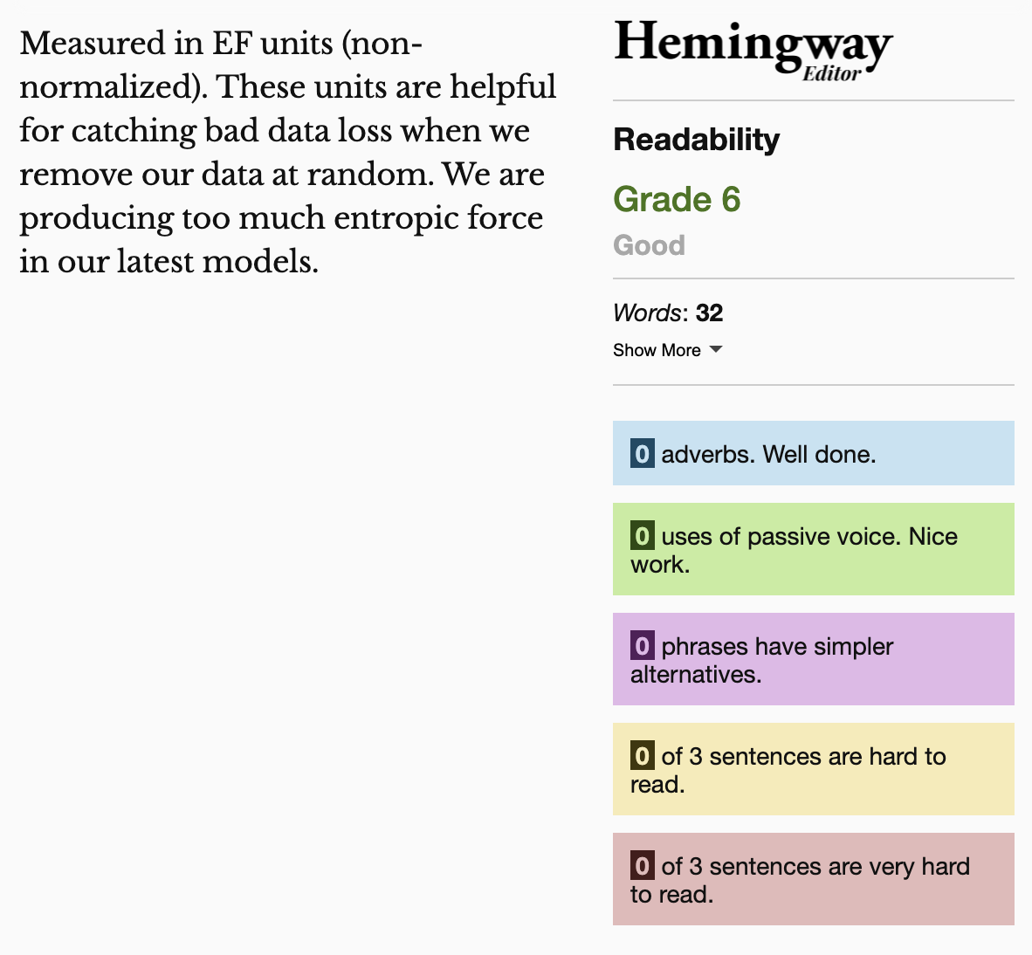
Keep summaries as non-technical as possible
If the topic is technical, provide a “plain language” summary somewhere close by that is easy to find (either in the same location or with by providing a link).

Slide 119




Recap: Understandability
Use concise, descriptive titles
Simplify your language
Add easy-to-access data or tables

Slide 120
Understandable Evaluation Toolkit:
Is there a descriptive title, summary, or caption?
Is there an accessible table or downloadable data file provided?
Is the descriptive text supporting the visualization presented at a reading level at grade 9 or below?

Slide 121
Continue this for:
Robust,
Compromising,
Assistive,
and Flexible

Slide 122
978 access failures found in ~60 minutes.
Robust:
275 - Does not conform to standards
82 - Semantically invalid
12 - Fragile technology support
Compromising:
54 - Information can only be reached through single process
61 - Information cannot be navigated according to narrative or structure
Assistive:
101 - Navigation and interaction is tedious
Flexible:
2 - User style change not respected
121 - User text adjustments are not respected
1 - Scrolling experiences cannot be adjusted or opted out of
Contrast and textures cannot be adjusted
Perceivable:
6 – Low contrast
57 - Content is only visual
50 - Color alone is used
3 - Meaningful elements can be distinguished
Operable:
54 - Interaction modality only has one input type
58 - No interaction cues or instructions
5 - Low contrast on interactive elements
4 - Keyboard focus indicator missing
4 - Complex actions have no alternative
18 - Target pointer interaction is too small
Understandable:
4 - Interactive context is not clear
6 - Metrics or variables are undefined
Notes:
Make sure to signal that this was from Chartability!!

Slide 123
Question for Frank

Slide 124





What and how of visualization accessibility
(My recent research)
Chartability:
What are accessibility barriers?
Data Navigator:
How do we build accessible visualizations?
Structure
Input
Rendering
To any visualization toolkit

Slide 125
Past problems:
Notes:
That leads us to the next concept: ability assumptions.

Slide 126
Problem 1: Do people who build stuff know what is or isn’t accessible?
Notes:
That leads us to the next concept: ability assumptions.

Slide 127
Problem 2: What do we do with all these pixels?
Notes:
That leads us to the next concept: ability assumptions.

Slide 128



Why are pixels so much trouble?
First demo link
Second demo link
Third demo link
Notes:
Make sure to signal that this was from Chartability!!

Slide 129

Accessible Streaming Software Infrastructure
Notes:
Game-aware streaming, by providing real-time game metadata, moves beyond simple translation or description of visual content into more interactive, customized experiences that cater to the needs of BLV viewers.
Our findings highlight the need for personalization and exploratory sense making in stream viewing.

Slide 130

Game-aware interfaces for streaming
Notes:
What did our interface enable? It allowed customization of font (size, color, and type) and language (such as French, Spanish, and English). It also allowed live dialogue following, so the interface text always showed what the streamer was viewing, as well as the option to explore past dialogue history of what had previously been on stream that users may have missed or wanted to explore.

Slide 131
Question for Frank

Slide 132
What are some “big-P” Problems in accessibility and visualization?
Notes:
That leads us to the next concept: ability assumptions.

Slide 133
Problem 1: Centering research and development on screen readers (not blind people) limits what we can do
Notes:
That leads us to the next concept: ability assumptions.

Slide 134

Screen readers processes 1 input at a time
Notes:
The best answer to the question is that accessibility for people with disabilities is a human right. There are some great articles drafted by the united nations on the rights of people with disabilities.
We should do this work because it is right to do. Simple enough.

Slide 135
Movement between tasks becomes cognitively expensive
Notes:
The best answer to the question is that accessibility for people with disabilities is a human right. There are some great articles drafted by the united nations on the rights of people with disabilities.
We should do this work because it is right to do. Simple enough.

Slide 136
Auditory processing struggles with dual-task paradigms*
*Citation
Notes:
The best answer to the question is that accessibility for people with disabilities is a human right. There are some great articles drafted by the united nations on the rights of people with disabilities.
We should do this work because it is right to do. Simple enough.

Slide 137
So what about cross-filtering?
Interactive link
Notes:
The best answer to the question is that accessibility for people with disabilities is a human right. There are some great articles drafted by the united nations on the rights of people with disabilities.
We should do this work because it is right to do. Simple enough.

Slide 138

So what about cross-filtering?
Notes:
The best answer to the question is that accessibility for people with disabilities is a human right. There are some great articles drafted by the united nations on the rights of people with disabilities.
We should do this work because it is right to do. Simple enough.

Slide 139
Interaction in one space…
Notes:
The best answer to the question is that accessibility for people with disabilities is a human right. There are some great articles drafted by the united nations on the rights of people with disabilities.
We should do this work because it is right to do. Simple enough.

Slide 140
Produces simultaneous, coordinated change in another.
Notes:
The best answer to the question is that accessibility for people with disabilities is a human right. There are some great articles drafted by the united nations on the rights of people with disabilities.
We should do this work because it is right to do. Simple enough.

Slide 141
For blind users, descriptions, structural navigation, and sonifications will likely not solve this challenge.
Notes:
The best answer to the question is that accessibility for people with disabilities is a human right. There are some great articles drafted by the united nations on the rights of people with disabilities.
We should do this work because it is right to do. Simple enough.

Slide 142
Preliminary research question:
How do blind people interact with multiple tactile media simultaneously?
Notes:
There are two common definitions. The first is broad: “Accessibility is the qualities that make an experience open or usable to all.” We might use this to say we are teaching data science to high schoolers, making the material more accessible. Or broadband internet access would be considered accessibility under this definition.

Slide 143

Observing: Embossed braille in a research context
Image source
Notes:
The best answer to the question is that accessibility for people with disabilities is a human right. There are some great articles drafted by the united nations on the rights of people with disabilities.
We should do this work because it is right to do. Simple enough.

Slide 144

Observation 1: Spatial memory storage
My friend didn’t remember the details of a math equation exactly, but he knew where that equation was located in his stack of braille pages and where on the page the equation was.
Image source
Notes:
The best answer to the question is that accessibility for people with disabilities is a human right. There are some great articles drafted by the united nations on the rights of people with disabilities.
We should do this work because it is right to do. Simple enough.

Slide 145
Observation 2: Coordinating perception and comparison
He then compared 2 equations at once. The details of each weren’t important. He was feeling for differences simultaneously.
Notes:
The best answer to the question is that accessibility for people with disabilities is a human right. There are some great articles drafted by the united nations on the rights of people with disabilities.
We should do this work because it is right to do. Simple enough.

Slide 146

Prototype 2: the cross-feelter, 2 motorized faders
Notes:
The best answer to the question is that accessibility for people with disabilities is a human right. There are some great articles drafted by the united nations on the rights of people with disabilities.
We should do this work because it is right to do. Simple enough.

Slide 147

One slider can work with video
Notes:
The best answer to the question is that accessibility for people with disabilities is a human right. There are some great articles drafted by the united nations on the rights of people with disabilities.
We should do this work because it is right to do. Simple enough.

Slide 148

While 2 sliders works for cross-filtering
Notes:
The best answer to the question is that accessibility for people with disabilities is a human right. There are some great articles drafted by the united nations on the rights of people with disabilities.
We should do this work because it is right to do. Simple enough.

Slide 149
A tactile display can render the input or output chart
Notes:
The best answer to the question is that accessibility for people with disabilities is a human right. There are some great articles drafted by the united nations on the rights of people with disabilities.
We should do this work because it is right to do. Simple enough.

Slide 150

Cross-coordination! A tactile, dual-task paradigm.
Notes:
The best answer to the question is that accessibility for people with disabilities is a human right. There are some great articles drafted by the united nations on the rights of people with disabilities.
We should do this work because it is right to do. Simple enough.

Slide 151
Question for Frank

Slide 152
Problem 2: Access Friction is when accessibility for someone produces a barrier for others
Notes:
That leads us to the next concept: ability assumptions.

Slide 153

What about this visualization might be a barrier?
Notes:
Let's say someone builds a pretty darn accessible chart – like this one shown here. Shown here is a sankey diagram. This chart visualizes flows and the flows look like pipes, or noodles, of different thicknesses. Noodles in the sankey that are thick like lasangna noodles have big numbers and the thin ones, like angel hair pasta, have small values. According to standard testing, this is really accessible.

Slide 154
What about this visualization might be a barrier?
Font size too small

Slide 155
What about this visualization might be a barrier?
Font size too small
Black text on light background is hard

Slide 156
What about this visualization might be a barrier?
Font size too small
Black text on light background is hard
Textures + colors are overwhelming

Slide 157
What about this visualization might be a barrier?
Font size too small
Black text on light background is hard
Textures + colors are overwhelming
Explanation doesn't have a summary, it isn't enough

Slide 158
Can we fix this?

Slide 159

Maybe we can bump up the text size

Slide 160

We can reduce visual complexity too

Slide 161

We can add a more descriptive explanation

Slide 162
Is this the perfect, most accessible design?

Slide 163
Bad news...

Slide 164
Bad news...
This design has accessibility issues too

Slide 165
There is no such thing as a single, perfect visualization

Slide 166
One design cannot fit all

Slide 167

Why should our chart designs be one-size-fits-all?

Slide 168

Good design enables personalization

Slide 169


We have been enabling personalization for years
Video games
Devices and operating systems
The Last of Us 2 has more than 60 settings
"Make it yours" is the motto for Apple's accessibility personalization

Slide 170

What if we let users personalize visualizations?
Interactive demo link
Notes:
That leads us to the next concept: ability assumptions.

Slide 171
Resources
Chartability workbook
Chartability paper
Chartability super audit
Data Navigator demo
Data Navigator paper
Softerware demo
Softerware paper (pre-print)
Our repo of visualization + accessibility resources
Notes:
That leads us to the next concept: ability assumptions.

